Slide 1
2024 Annual Meeting
Marblehead
January 13, 2024

Slide 2
AGENDA
Call to Order
Commodore’s Welcome
Approval of the Previous Meeting Minutes
Reports of the Officers
Secretary
Treasurer
Fleet Captain
Rear Commodore
Vice Commodore
Commodore
Reports of the Committees
Membership
Foundation
Rating Rules
Long Range Committee
Nominating
Elections
New Business
Trophy/Gift Presentation
25 year Pins
50 Year Pins
Outgoing Governors
Season Long Excellence Trophies
Monte-Sano Trophy
Richard M. Stimson Offshore Navigation Trophy
Awards Recognizing Club Wide Excellence
The Hugh Kilmer
The Torrey Trophy
Adjournment

Slide 3
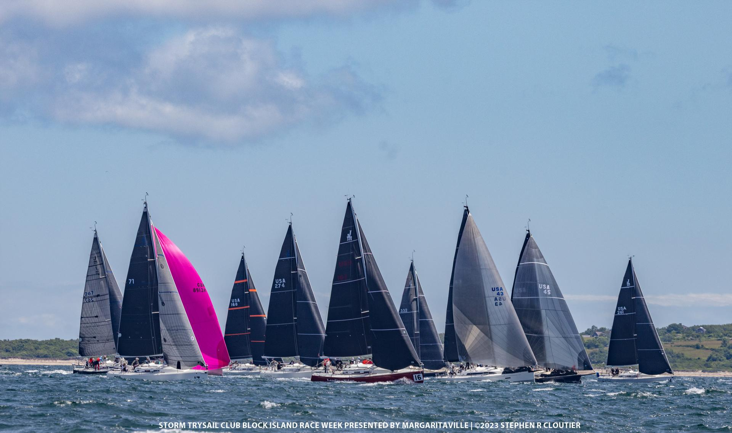
SECRETARY’S REPORT
John Browning

Slide 4
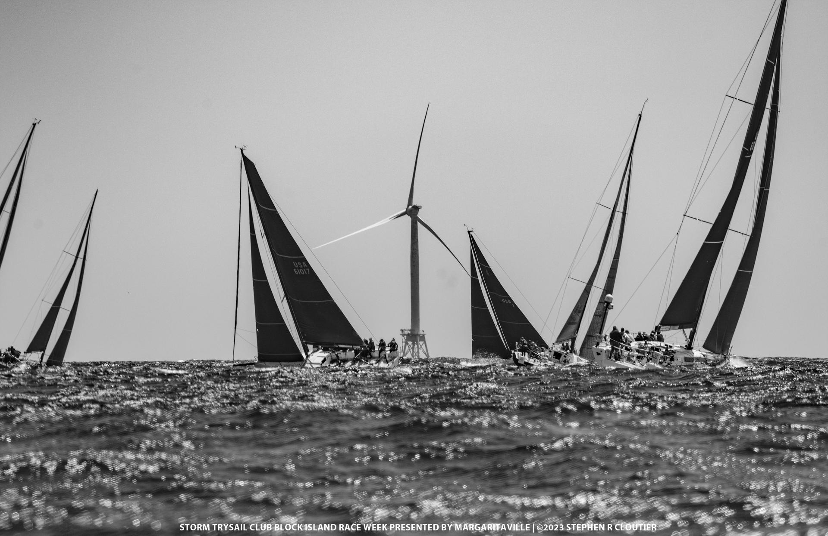
TREASURER’S REPORT
Bud Heerde

Slide 5
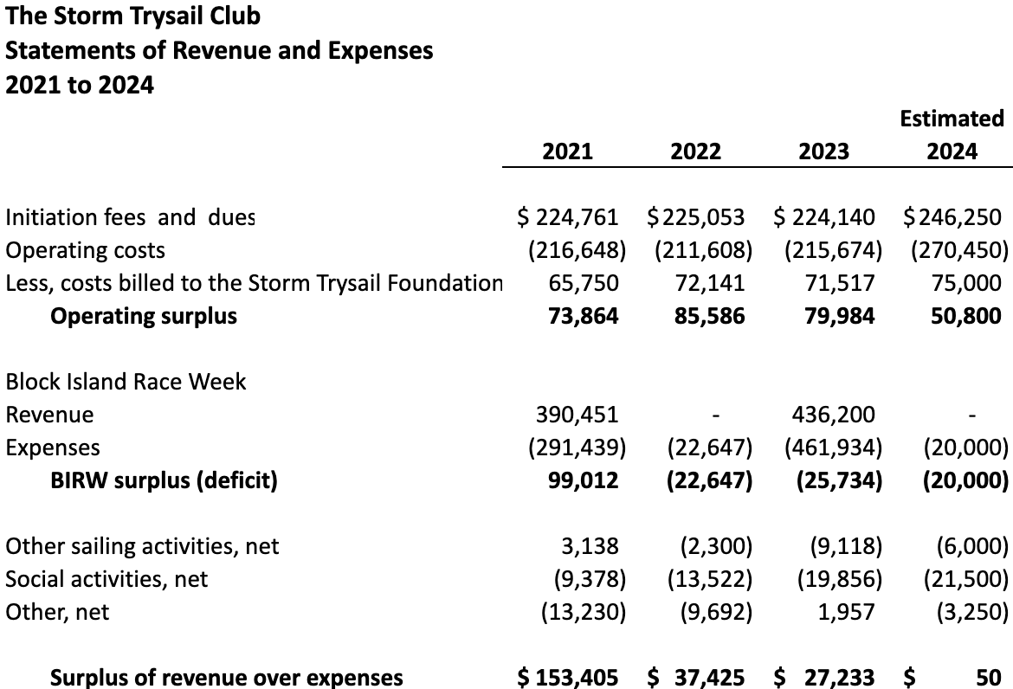
TREASURER’S REPORT

Slide 6
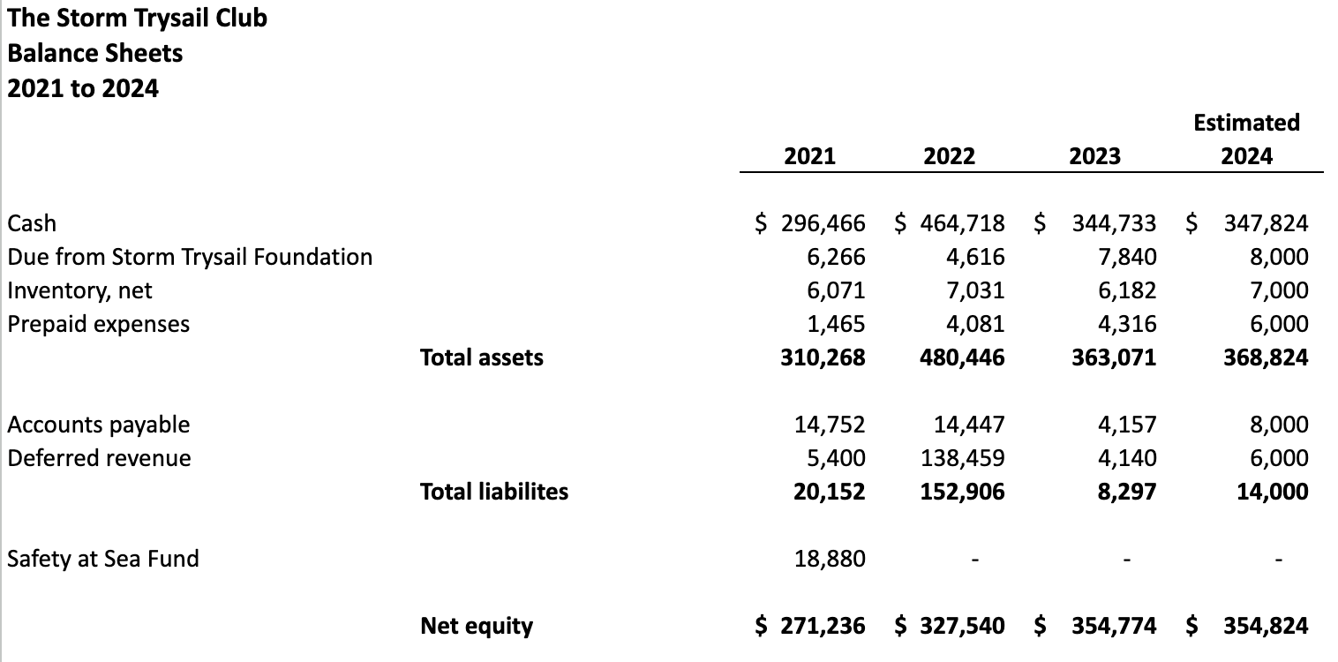
TREASURER’S REPORT

Slide 7
Effective January 1, 2024, Dues and Initiation Fees shall be as follows:
TREASURER’S REPORT
 | Current |  |  | Proposed
 | Dues* | Initiation fees |  | Dues* | Initiation fees
Regular | $200 | $400 |  | $225 | $450
Regular member under 30 | $200 | $135 |  | $225 | $150
Corinthian | $200 | $200 |  | $225 | $450
Corinthian member under 30 | $200 | $135 |  | $225 | $150
Associate | $200 | None |  | $225 | None
Junior | $125 | None |  | $140 | None
Senior | $70 | NA |  | $80 | NA
Overseas | $70 | $135 |  | $80 | $150
* If the date of election is after September 1, dues for the year of election are waived. Once a Regular Member reaches age 90, yearly dues are waived.

Slide 8
Only Regular or Senior members should answer this question.
2024 ANNUAL MEETING BALLOT
Do you approve the schedule of dues, initiation and late fees proposed by the Treasurer?
Dues: Senior $80 (Overseas $80); Regular, Corinthian and Associate $225; Junior $140.
Initiation Fee: 200% of the annual Regular Member dues and $150 for Regular Members under the age of 30. Junior and Associate Members pay no initiation fee.
Late Fee: $20 added after 60-days.

Slide 9
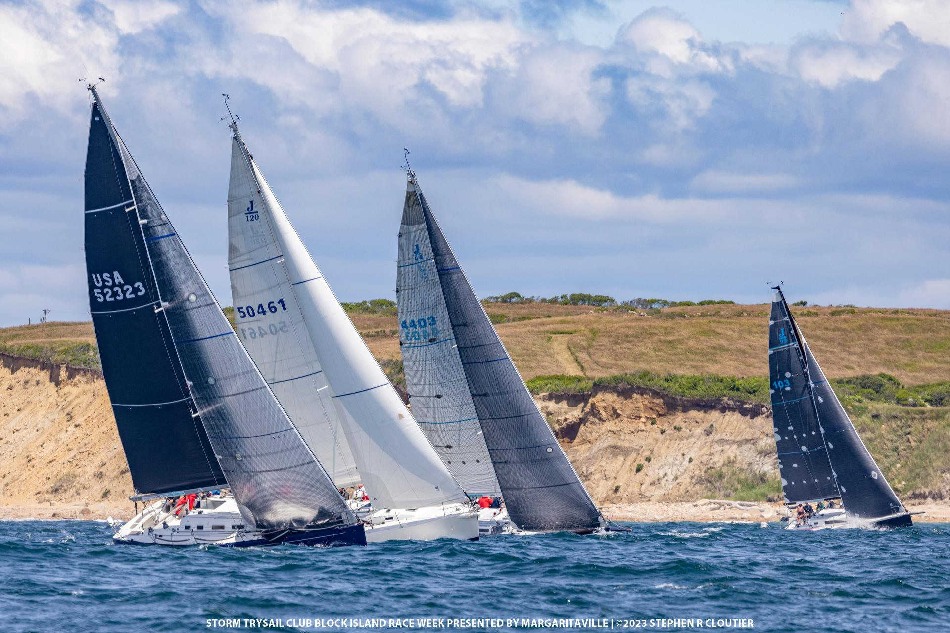
FLEET CAPTAIN’S REPORT
RICK ROYCE

Slide 10
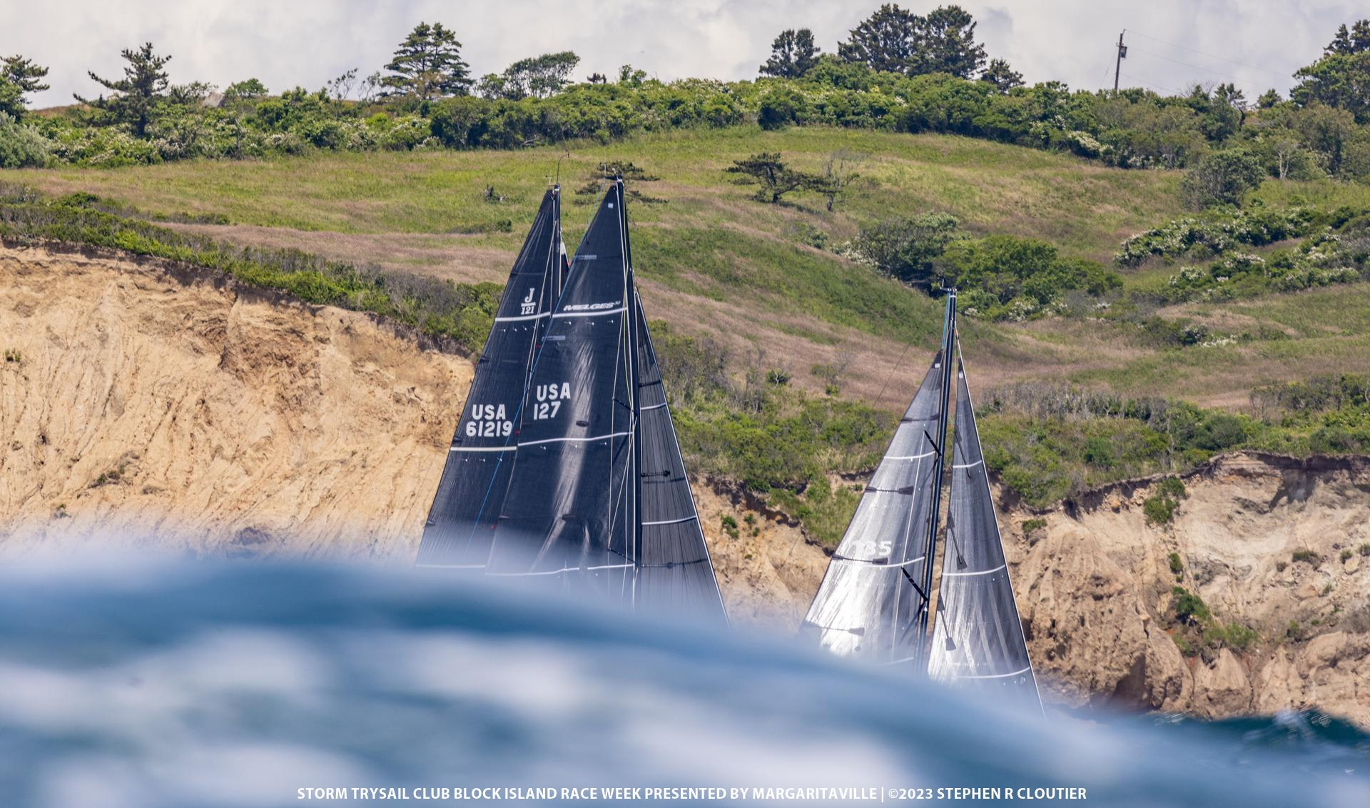
REAR
COMMODORE’S REPORT
TY ANDERSON

Slide 11
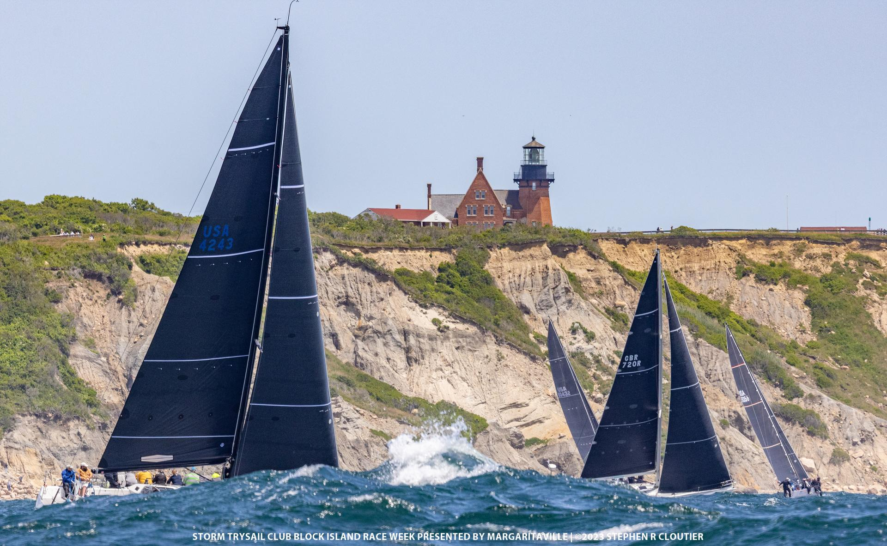
VICE
COMMODORE’S REPORT
ANDREW WEISS

Slide 12
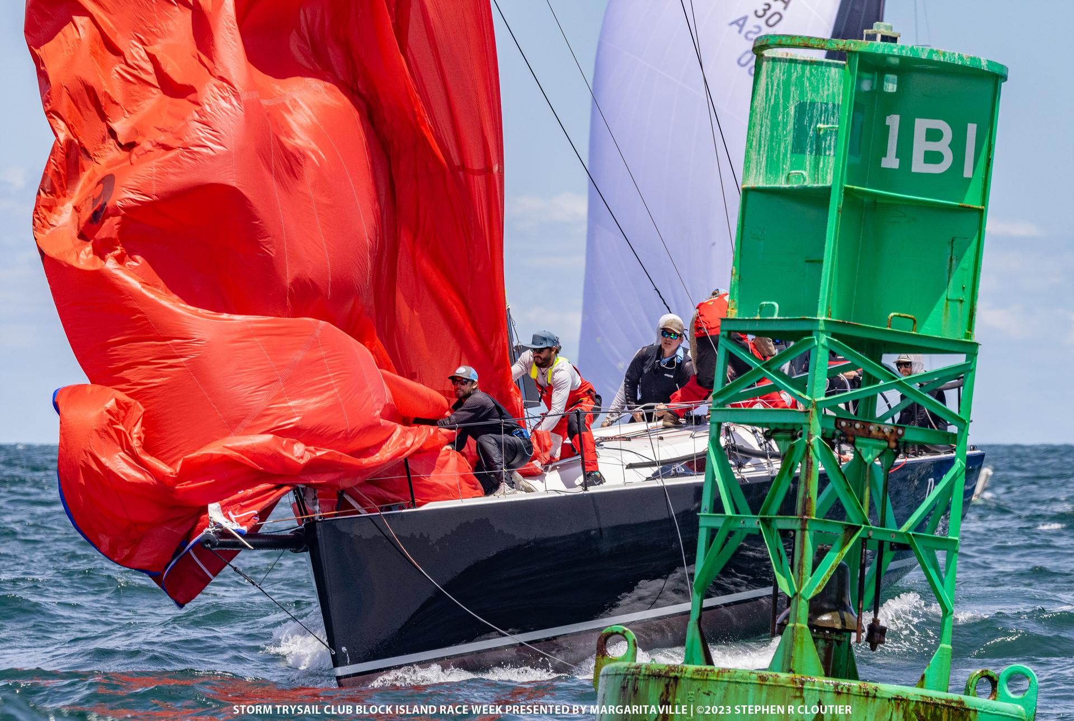
COMMODORE’S REPORT
RAY REDNISS

Slide 13
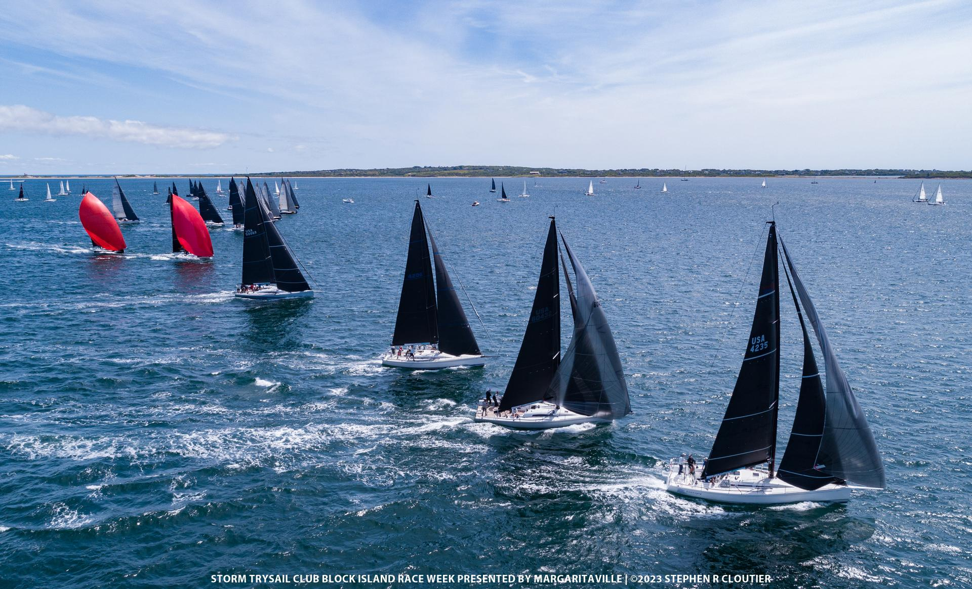
MEMBERSHIP COMMITTEE’S REPORT
MATT GALLAGHER

Slide 14
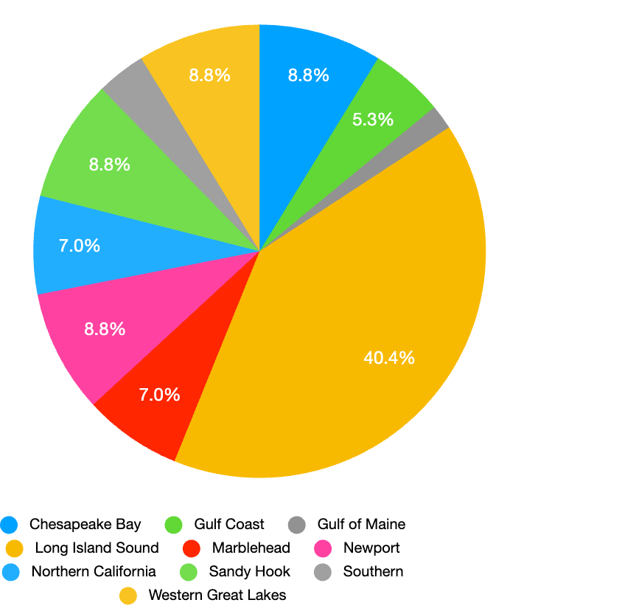
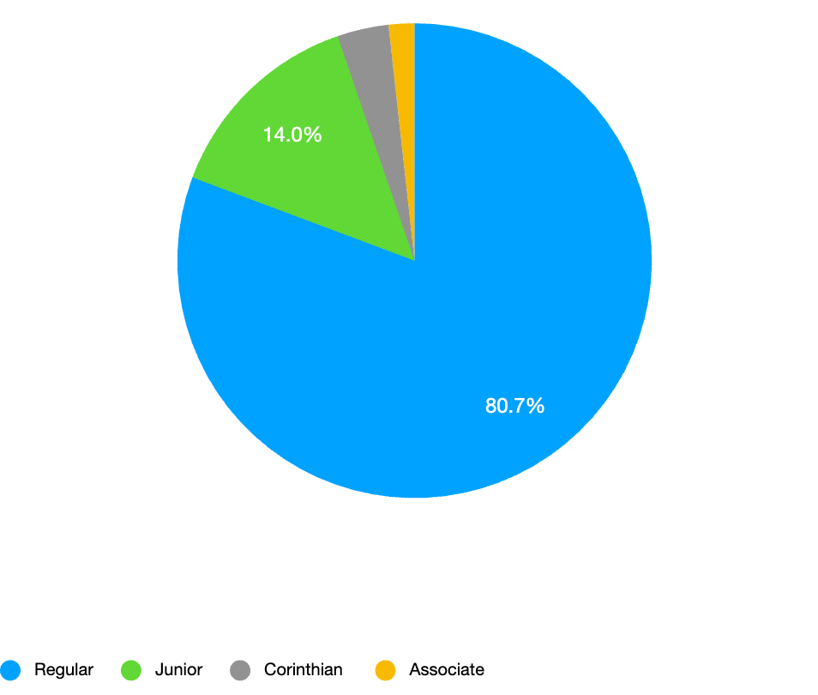
New Members by Category
New Member by Station
Membership
Committee Report
Member Type | 2023
Regular | 46
Junior | 8
Corinthian | 2
Associate | 1
Total | 57
Station | 2023
Chesapeake Bay | 5
Gulf Coast | 3
Gulf of Maine | 1
Long Island Sound | 23
Marblehead | 4
Newport | 5
Northern California | 4
Sandy Hook | 5
Southern | 2
Western Great Lakes | 5
Total | 57

Slide 15
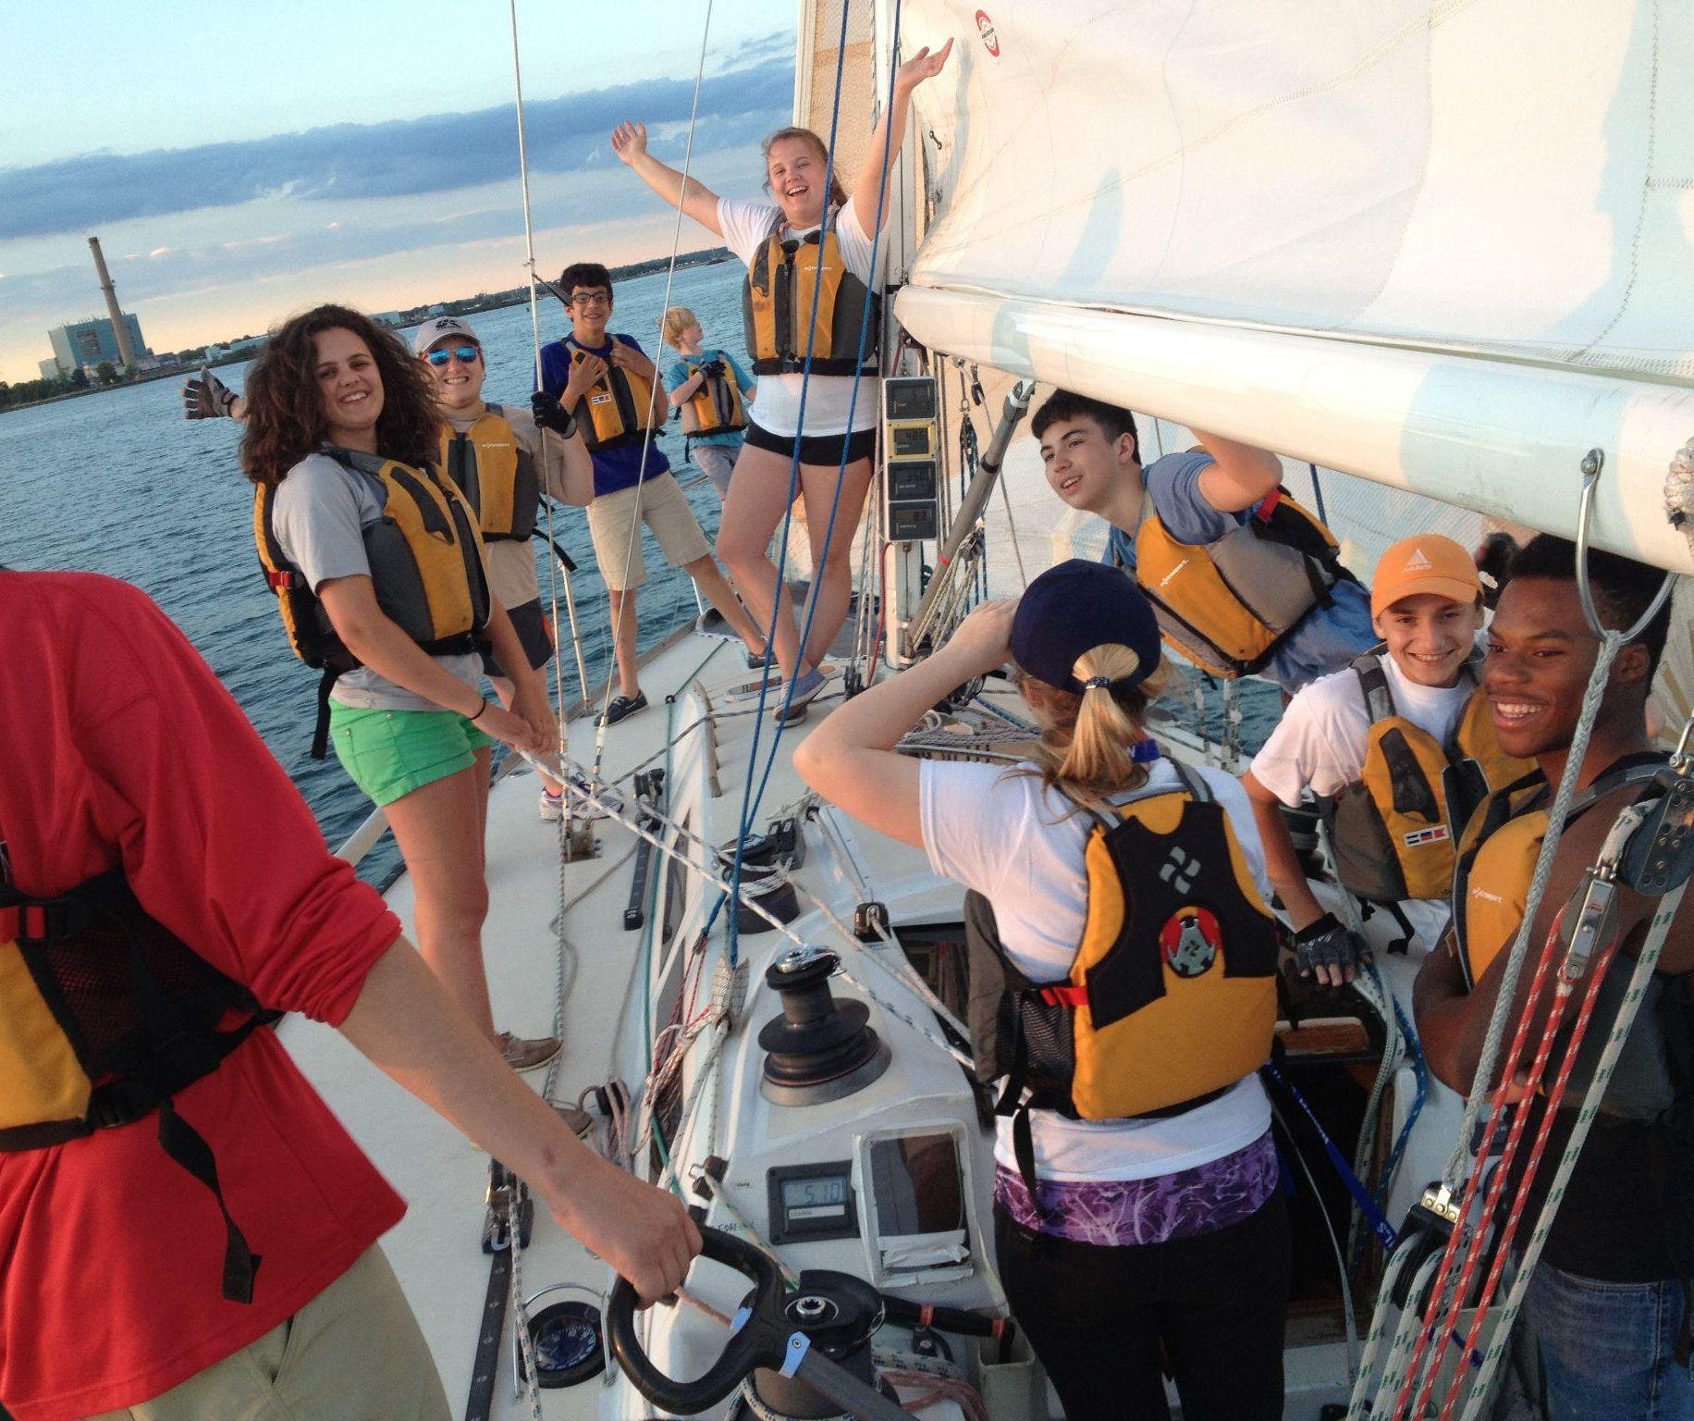
STORM TRYSAIL FOUNDATION REPORT
RICH DU MOULIN

Slide 16
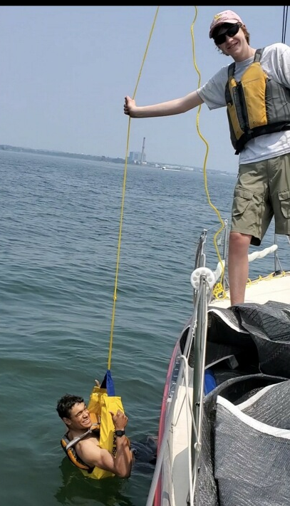
STORM TRYSAIL FOUNDATION REPORT
Our Mission
“…..dedicated to effecting, promoting and enhancing (i) the education of young sailors, (ii) safe and knowledgeable transitioning from dinghy to big boat racing, particularly through intercollegiate big boat racing, (iii) safe boat handling in all conditions for all sailors, (iv) safe blue water racing and passage making for all sailors, and (v) leadership, seamanship, and navigation, and (vi) environmental stewardship.”

Slide 17
STORM TRYSAIL FOUNDATION REPORT
2023 ACTIVITIES
Safety at Sea
Adult & Junior
9 Seminars
265 Adults Trained
240 Juniors Trained
Community Sailing
11 Programs Supported
$35000 in Grants
Sea
Scouts
4 “Ships” Supported $10000 Total Grants
Intercollegiate Offshore Regatta
32 Colleges
41 Boats
280 Sailors

Slide 18
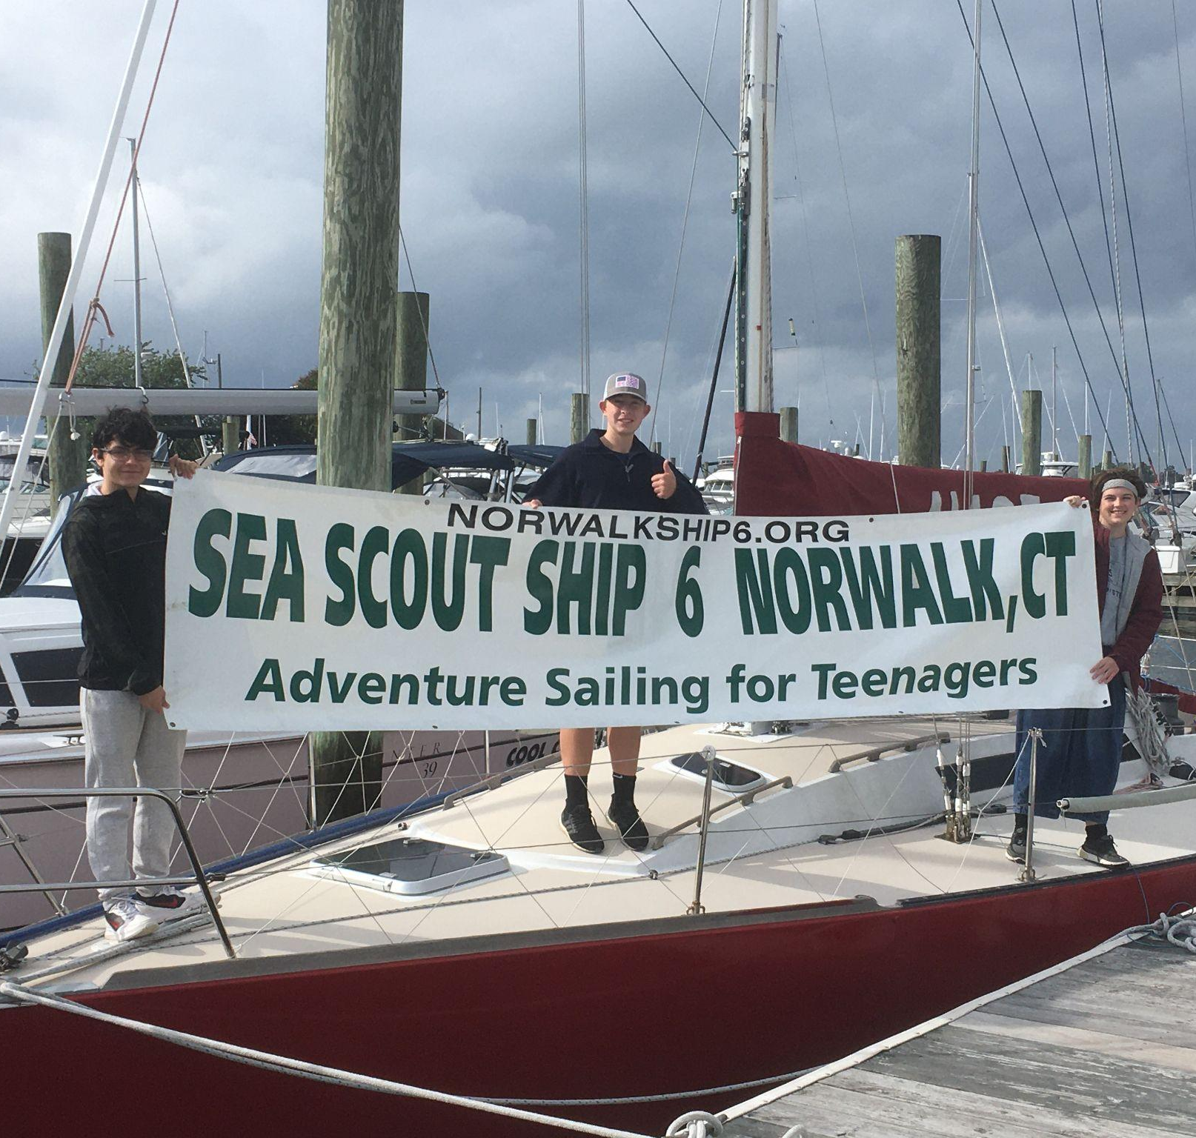
STORM TRYSAIL FOUNDATION REPORT
COMMUNITY OUTREACH GRANTS
2020: 3 grants $7,500 (total)
2021: 11 grants $23,500
2022: 15 grants $39,500
2023: 11 grants $44,375
2024: Budget $47,500

Slide 19
STORM TRYSAIL FOUNDATION REPORT
Community Outreach: Grantees and STC Liaisons
COSC Ed Cesare
Hudson River Community Sailing Kelly Robinson
Sound Waters Ray Redniss
Save the Sound Ray Redniss
Mudratz Taylor Walker
Rocking the Boat Lars Forsberg
Norwalk Sea Scouts-Ship 6 Andy Berdon
Houston Sea Scouts- Ship 468 Chris and Karen Lewis
Chicago Sea Scouts-Ship 5111 Michael Hettel
Chicago Sea Scouts- Ship 5870 Ray Groble
Edward Teach Youth Sailing Ray Redniss
America True Scholarships Dawn Riley
Youth Sailing Vero Beach George Hinman
Oliver Hazard Perry Jonathan Kabak

Slide 20
STORM TRYSAIL FOUNDATION REPORT
$15,000+
Donor Pyramid
3
$10,000
3
$5,000
4
$2,500- $4,999
10
$1,000- $2,499
13
$25- $99
135
Total: 168 (10% increase from 2023)

Slide 21
Special thanks to our lead donors
$15,000 + Bo & Edie Lycke, David Askew,
Hunt Lawrence
$10,000 Andrew Berdon, Rives Potts, Rich du Moulin
$5,000 Ray Redniss, Lenny Sitar,
Reinhold Foundation, Zupon Foundation
$2,500-$4,999 Benoit, Browning, Cummiskey, Grant, Hutton,
Krediet, Litchfield, Mele, Schoen, Weiss
$1,000-$2,499 Austin YC, Dierdorff, Edgecomb, Gallagher, Hettel, Hilf, Holland, Lewis, McKiege, Minninger, Olsson, Osmond, Schulte,
$25- $999 135 members & friends

Slide 22
STORM TRYSAIL FOUNDATION REPORT
2024 FINANCIAL GOAL
Increase our overall donation amount by 25% to $250,000.
Increase donor base by 33% to 225 donors.
Increase first time donors by 50
The bulk of these new donors will be in the under $1,000 category. This is the strong base of a healthy Club and Foundation.

Slide 23
STORM TRYSAIL FOUNDATION REPORT
Board of Directors:
Advisors:
STC Commodore- Ray Redniss
Chairman- Rich duMoulin
Sec/Treasurer- John Browning
Counsel- Lars Forsberg
Eric Kreuter
Mike Toppa
David Askew
Gary Jobson
STC Exec Director- Whitney Simon
Accountant- Sharon Bernd
Annual Fund- Steve Minninger & Chris Reichart
STC Treasurer- Bud Heerde
THANK YOU FOR ALL YOUR HELP, ADVICE AND FINANCIAL SUPPORT

Slide 24
STORM TRYSAIL FOUNDATION REPORT
Board of Directors:
Advisors:
STC Commodore- Ray Redniss
Chairman- Rich duMoulin
Sec/Treasurer- John Browning
Counsel- Lars Forsberg
Eric Kreuter
Mike Toppa
David Askew
Gary Jobson
STC Exec Director- Whitney Simon
Accountant- Sharon Bernd
Annual Fund- Steve Minninger & Chris Reichart
STC Treasurer- Bud Heerde
THANK YOU FOR ALL YOUR HELP, ADVICE AND FINANCIAL SUPPORT

Slide 25
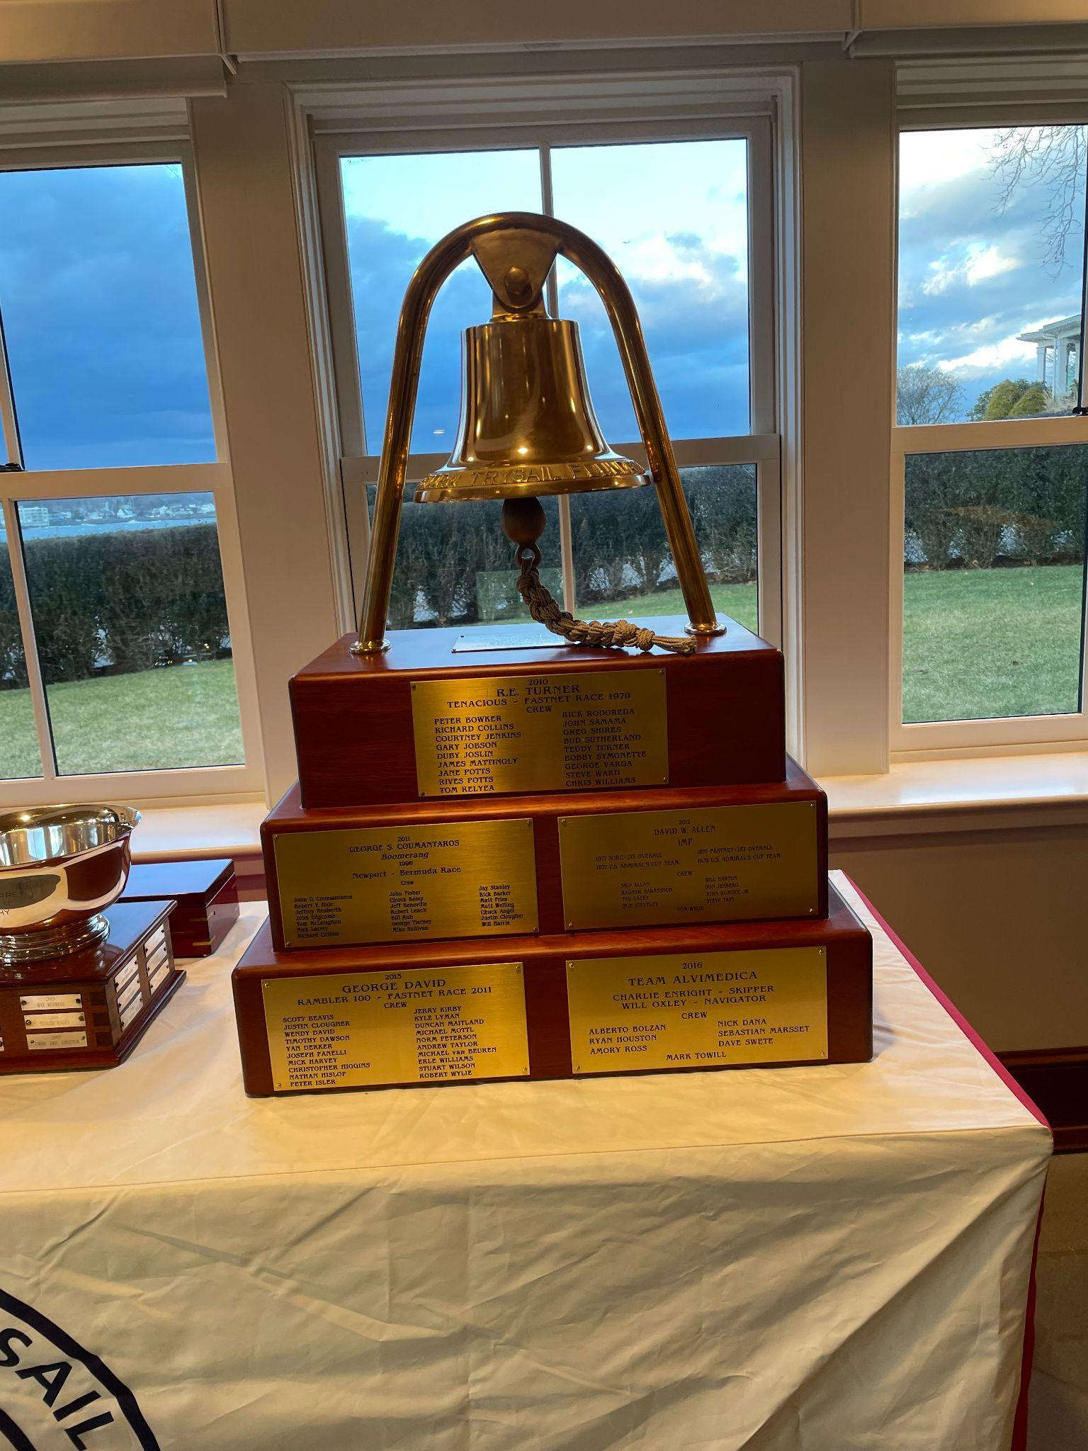
STC Foundation Seamanship Bell
This bell represents the rich heritage and tireless spirit of the great sport of ocean sailing.
It will be awarded to honor the Skippers, the crews, their yachts and to highlight the many historical and noteworthy blue water passages of our past.

Slide 26
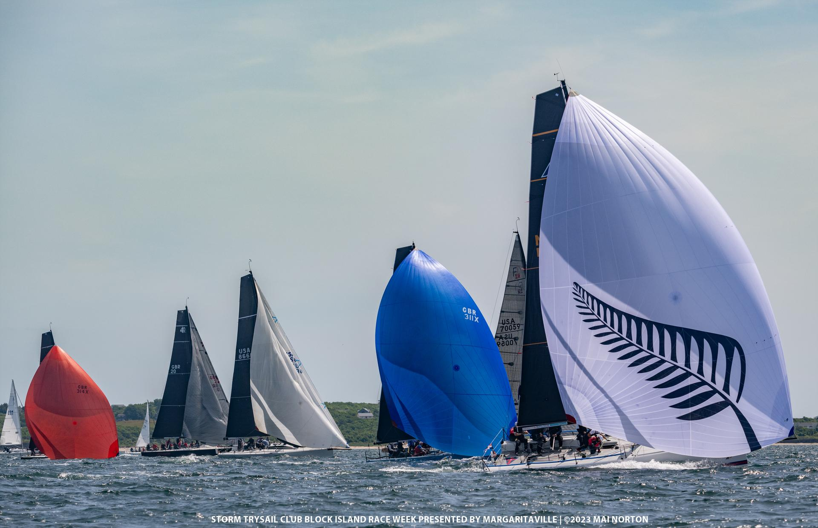
Rating Rules
LARRY FOX

Slide 27
Racing Rules in Use by the Storm Trysail Club and its Partner Clubs for 2024
RATING RULES REPORT
The Storm Trysail Club believes that too many handicap rating rules injures the quality of racing and reduces participation. Our focus in 2024 remains on two rules:
PHRF as our preferred performance-based rule for regional and local handicap racing
ORC as our preferred measurement rule for regional / national / international regattas.
We will continue to support One Design racing wherever applicable.
PHRF remains far and away the most used rule in US handicap racing. Our 2024 goal is continued support for and strengthening of PHRF.
ORC is STC's selection for a measurement-based rule.
ORC has made exceptional efforts to support US sailors and our requests through US Sailing.
ORC continues to invest in the improvement of the VPP to promote fair racing.
ORC has a stable professional organization with sufficient size and finances.
ORC is a global leader; certificates are portable and can be used in any ORC race.
ORC treats STC as a valued partner, providing us with access and influence.
Our relationship with ORC brings the club recognition and influence.
For 2024, STC recommends that ORCi certificates be required for boats with APH 500 or below, and for boats with modified hull or appendages regardless of rating.

Slide 28
2024 ORC Rule Developments – Material Changes to Rating and Scoring
RATING RULES REPORT
Update to the VPP Residuary Resistance Model. This effects resistance-based calculations in the VPP.
Corrections to VPP Depowering Scheme. This improves accuracy of the VPP in depowering the sail plan through reefing and flattening as a function of heel angle.
Weather Routing Scoring (WRS). A means of rating boats for a given race based on the PredictWind Routing Engine, PredictWind Forecasts (weather gribs), the ORC Polar Table, and the course. Preliminary results from the Miami to Nassau Race were very encouraging
Addition of 24 kn to the VPP, now: 6, 8, 10, 12, 14, 16, 20 and 24 kn.
Update NA Scoring Options: Revise NA Specific 5-Band True Wind Matrix to include 24 kn using existing methodology and implement for W/L and Predominant Upwind, Downwind and Reaching courses.
Assess and rate benefit of mast jack pump in similar manner to the current rating of adjustable forestays.
Yachts can now fly HSFs inside spinnakers without handicap adjustment.

Slide 29
Spring 2024 ORC Education Series – Sessions Schedule
RATING RULES REPORT
Date | Session Content | STC Participants / Roles
Friday, February 1 | Intro to ORC, obtaining a Certificate | Kevin Foote (CYC) is lead; STC Vice Commodore Weiss (if available)
Thursday, February 28 | Measurement and Optimization | Chris Tutmark (STC / US Sailing Offshore Office) is lead; Dobbs Davis and STC Vice Commodore Weiss (if available)
Wednesday, March 13 | Intro to Scoring | Past STC Commodore Ed Cesare (NYYC) is lead; supported by Larry Fox (STC)
Wednesday, April 10 | Advanced Scoring for Sailors | Larry Fox (STC) is lead; will also try to involve Stan Honey if available.
TBD | Race Management using ORC for RC Members | STC to lead: Ideally would like to include Ray, Dick, Bruce, and Andree as a “PRO Panel” with support from Larry on the technical issues
All sessions will be broadcast over Zoom and available to the entire community. Links will be provided by the participating clubs.

Slide 30
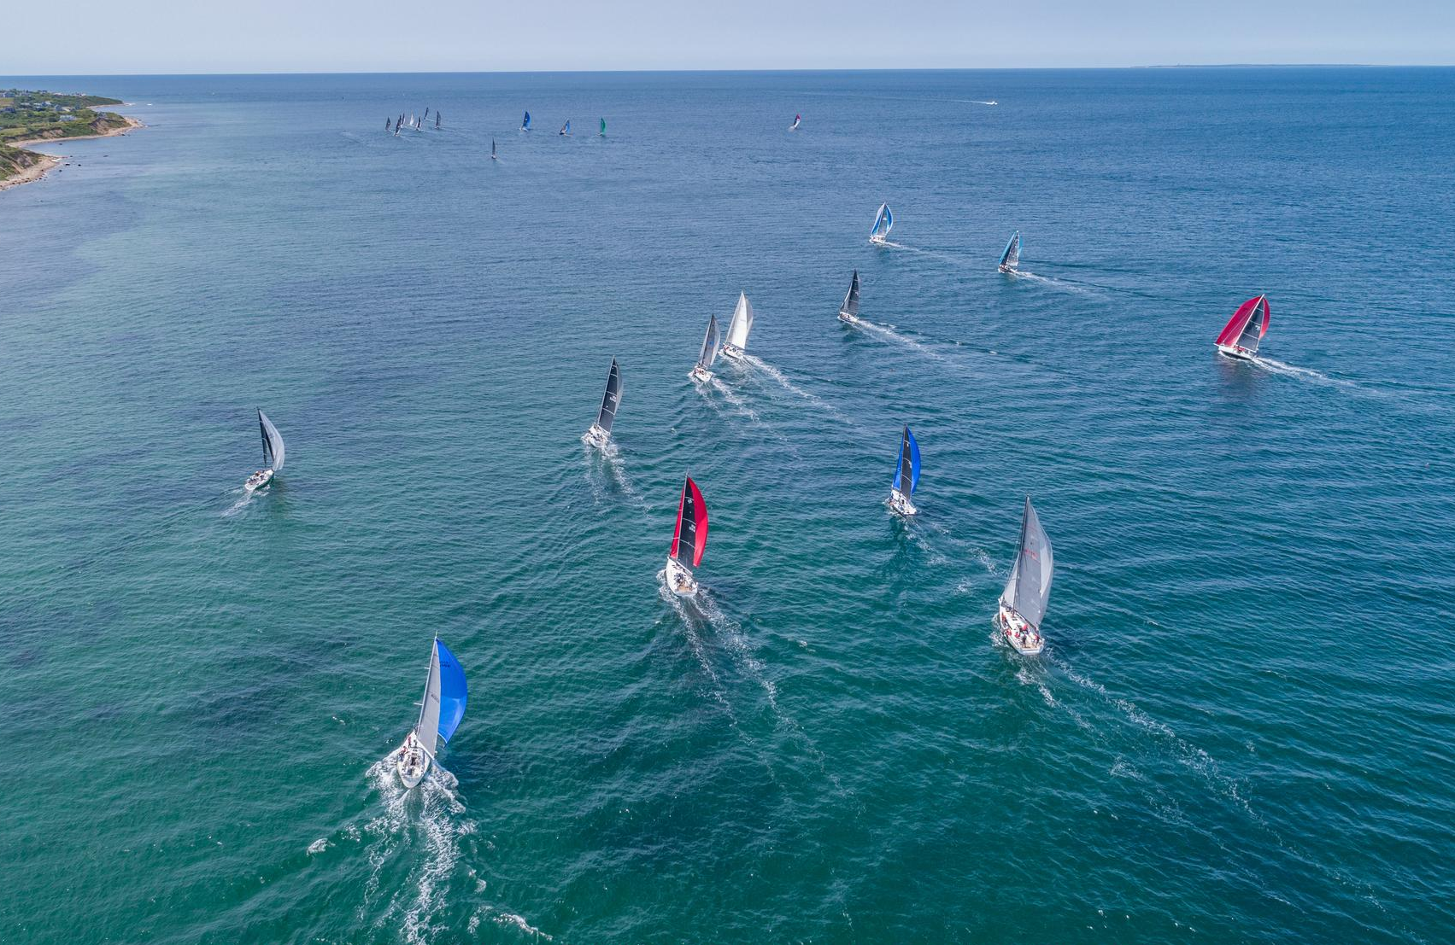
Long Range Committee
Gary Jobson, Chair
Ty Anderson (Presenting)
Richard du Moulin
A.J. Evans
Johanna Moffitt
Steve Prime
John Storck III

Slide 31
Long Range Committee Report
Current Mission Statement:
“The purpose of the Club is to promote good fellowship among blue water sailors and ocean racing sailors, and to encourage the sport of ocean racing and offshore cruising.”
Proposed New Wording of Mission Statement:
“The purpose of the Club is to promote good fellowship among blue water and ocean racing sailors, to encourage the sport of ocean racing and cruising, and to promote seamanship, safety at sea and leadership skill.”

Slide 32
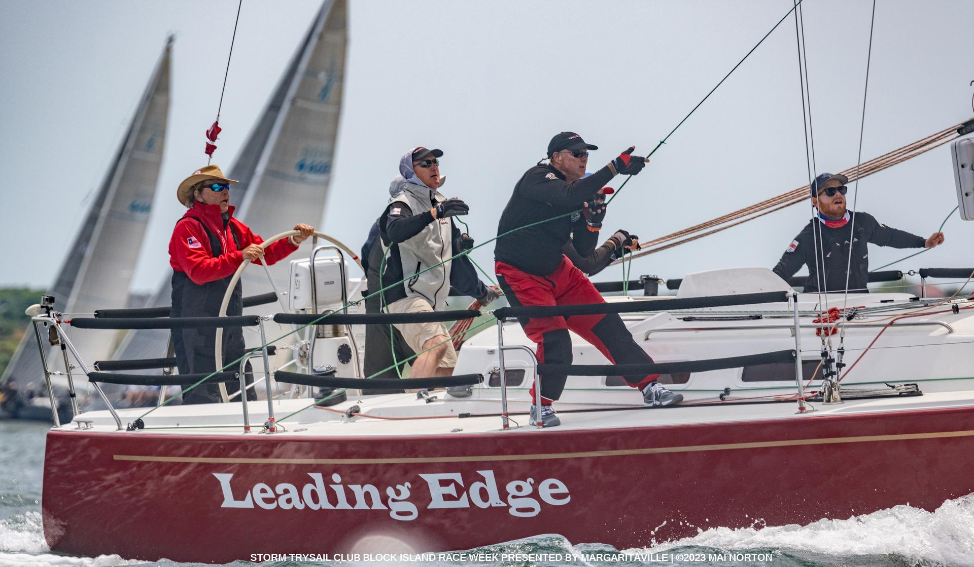
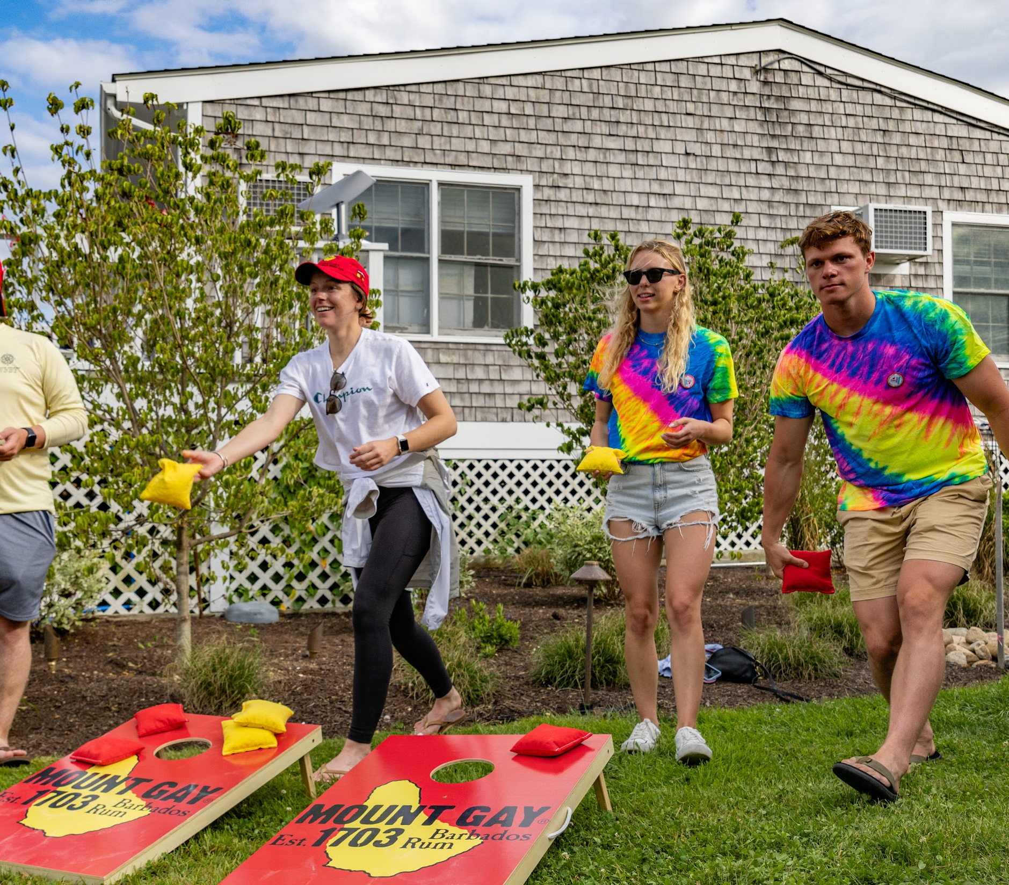
Long Range Committee Report
CURRENT ACTIVITIES
The Long-Range Planning committee suggests publishing a set of standards and requirements
for regattas and events.
An important question is:
What sort of events do we want to host?

Slide 33
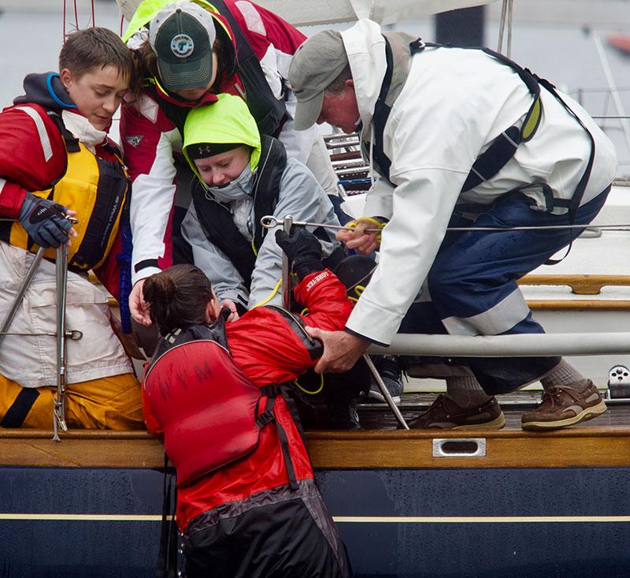
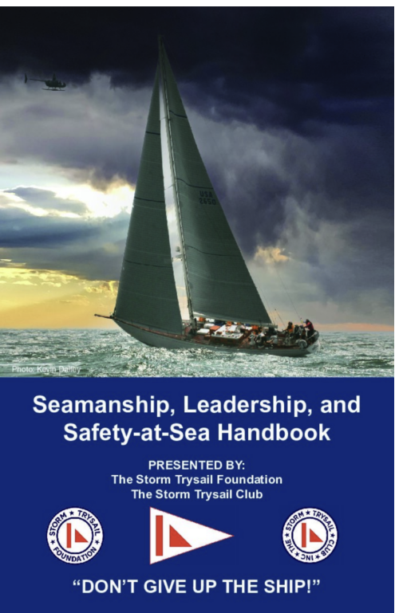
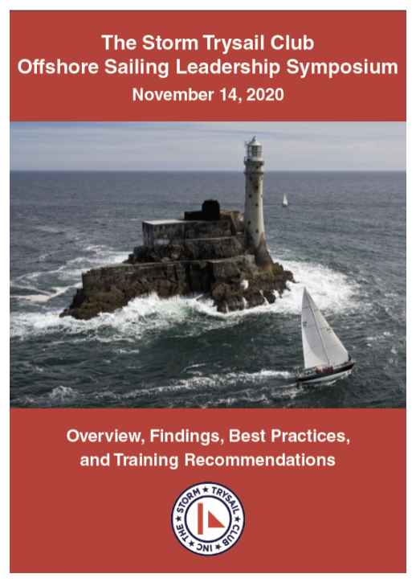
Long Range Committee Report
EDUCATION
Safety-at Sea Seminars
Junior Safety-at-Sea Seminars
Handicap Rating Rules
Develop Improved Man Overboard Recovery Procedures
Seamanship and Leadership at Sea Safety-at-Sea Video Series (currently 15 video inventory)
Seamanship, Leadership and Safety-at-Sea Handbook

Slide 34
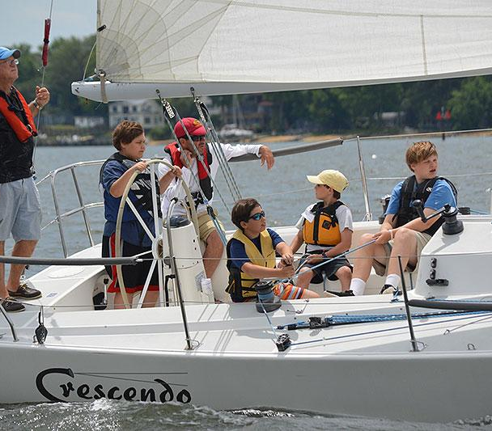
Long Range Committee Report
STORM TRYSAIL FOUNDATION
The Long-Range Planning Committee recognizes the excellent relationship between the Storm Trysail Club and the Storm Trysail Foundation.
The Club should continue to encourage all members to generously support the Foundation.

Slide 35
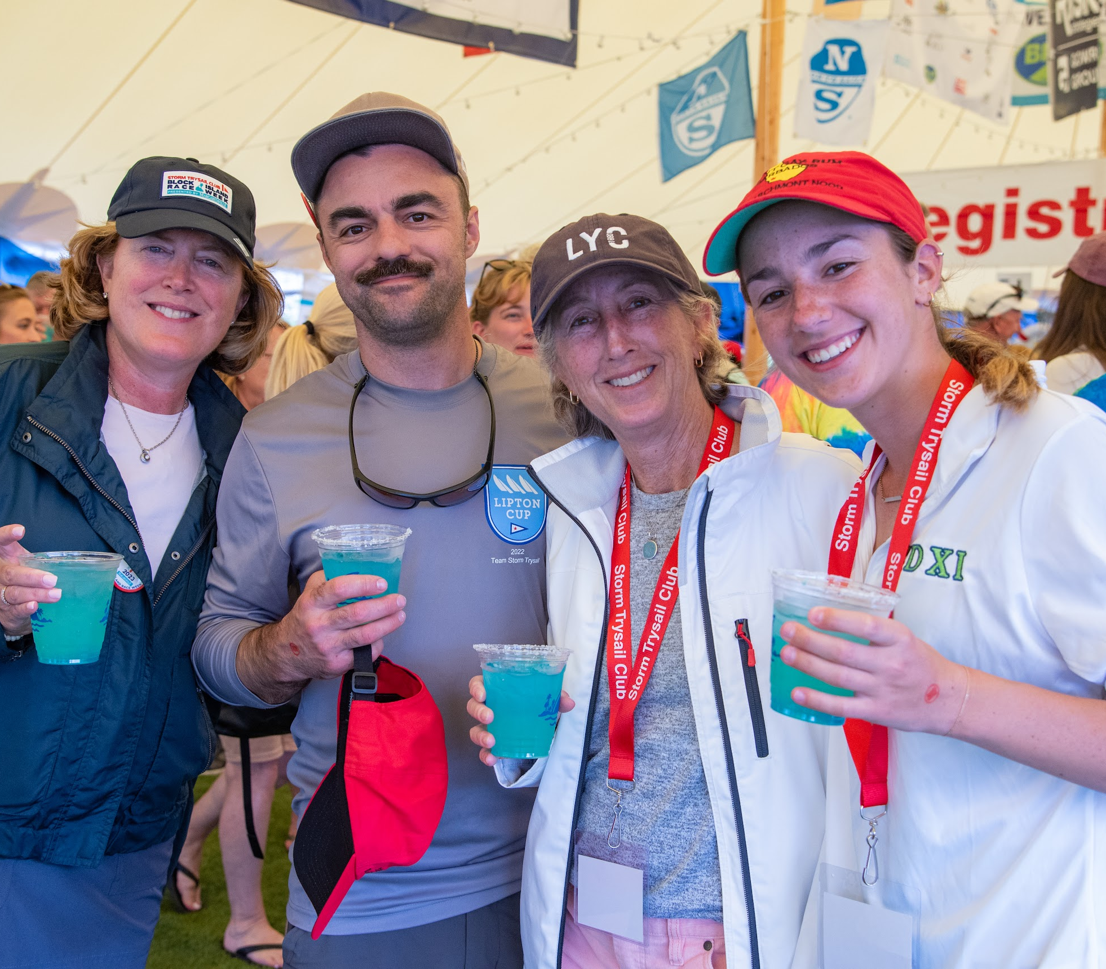
Long Range Committee Report
VALUE PROPOSITION
Influence the direction of the sport through the quality of Storm Trysail members and prominent role the Club and its members play in the sport of ocean racing.
Organize educational events by adding junior and adult Safety-at Sea Seminars, Intercollegiate Offshore Regatta, Offshore safety, and community outreach.
Promote our role in ocean racing, including Safety-at-Sea training, the advancement of seamanship and leadership skills and race management.
Welcome using crossed burgees with other clubs.

Slide 36
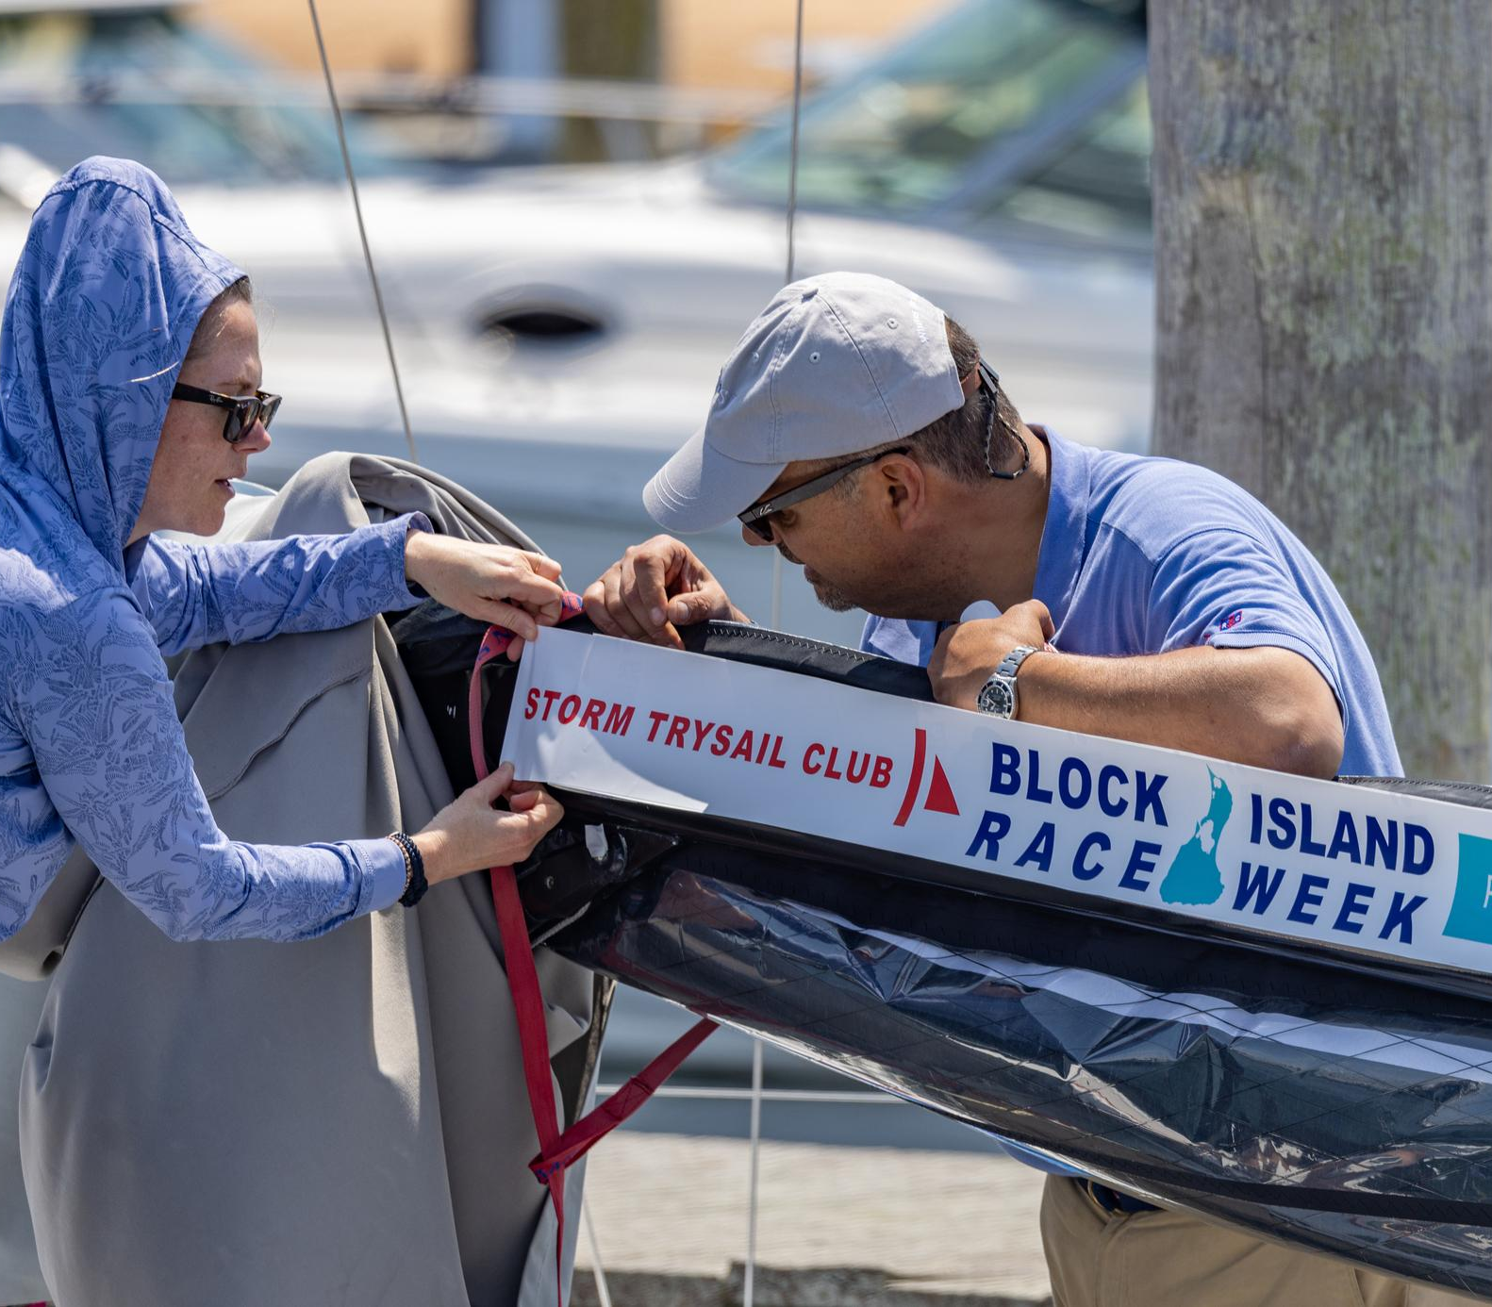
Long Range Committee Report
SIGNATURE EVENT
The Storm Trysail’s Club’s signature event is Block Island Race Week.
The LRP Committee suggests a discussion about increasing participation by partnering with existing long-distance races and possibly adding a new 600-mile offshore race.

Slide 37
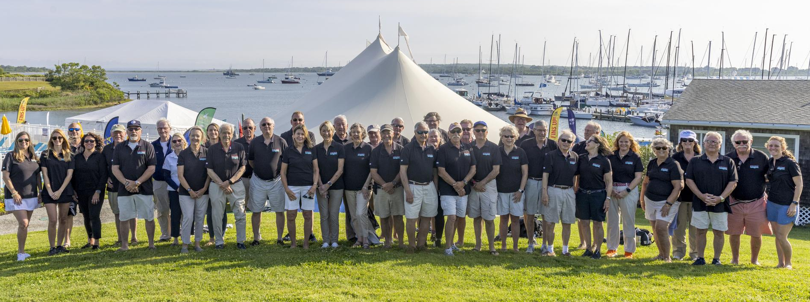
Long Range Committee Report
VOLUNTEERISM
Encourage a culture of volunteerism.
Activate STC Stations to run local events with station volunteers.
Volunteers should be recruited well in advance of an event.

Slide 38
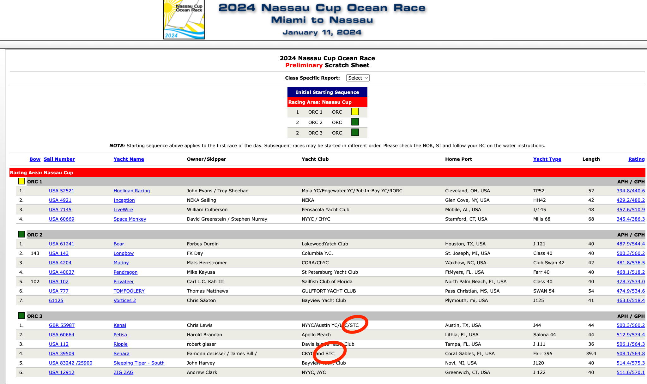
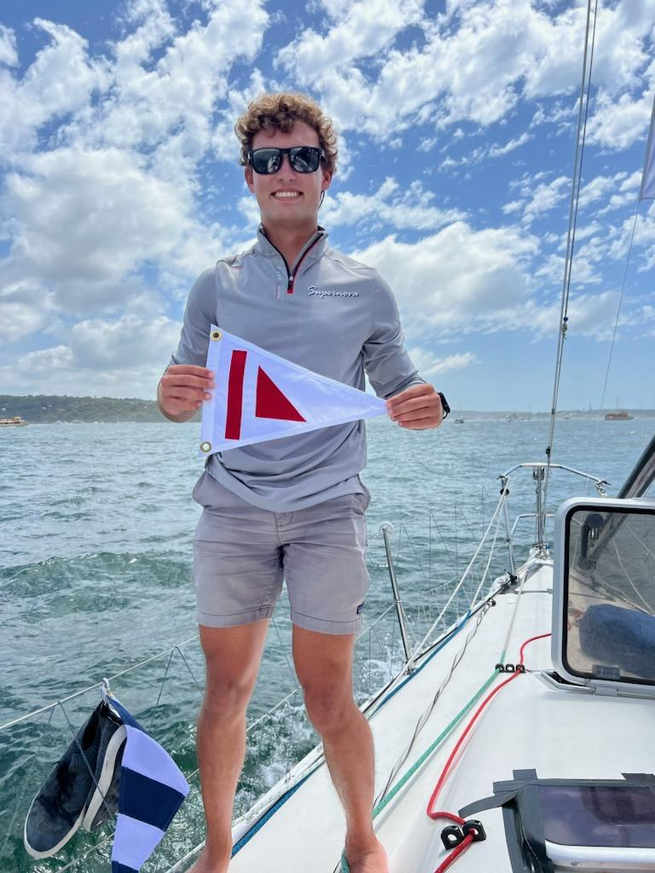
Long Range Committee Report
CLUB PRIDE
The LRP Committee encourages the use of the guidelines in the STC Branding Guidebook.
STC should promote sailing under the Club’s burgee when entering regattas and sharing with the leadership and office.

Slide 39
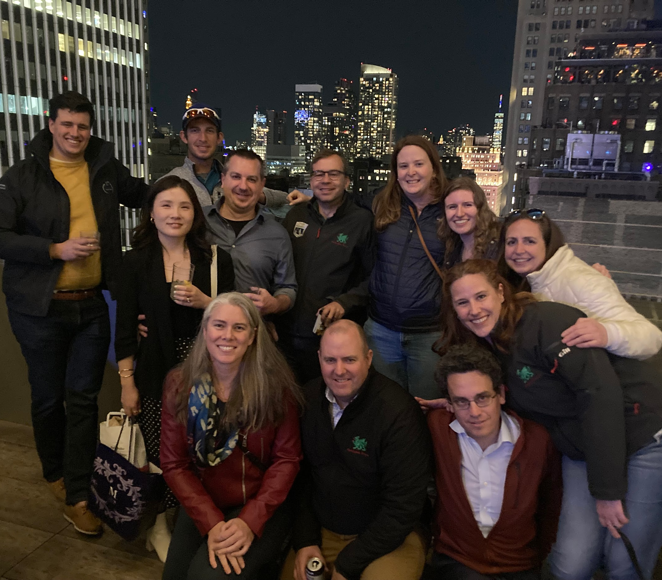
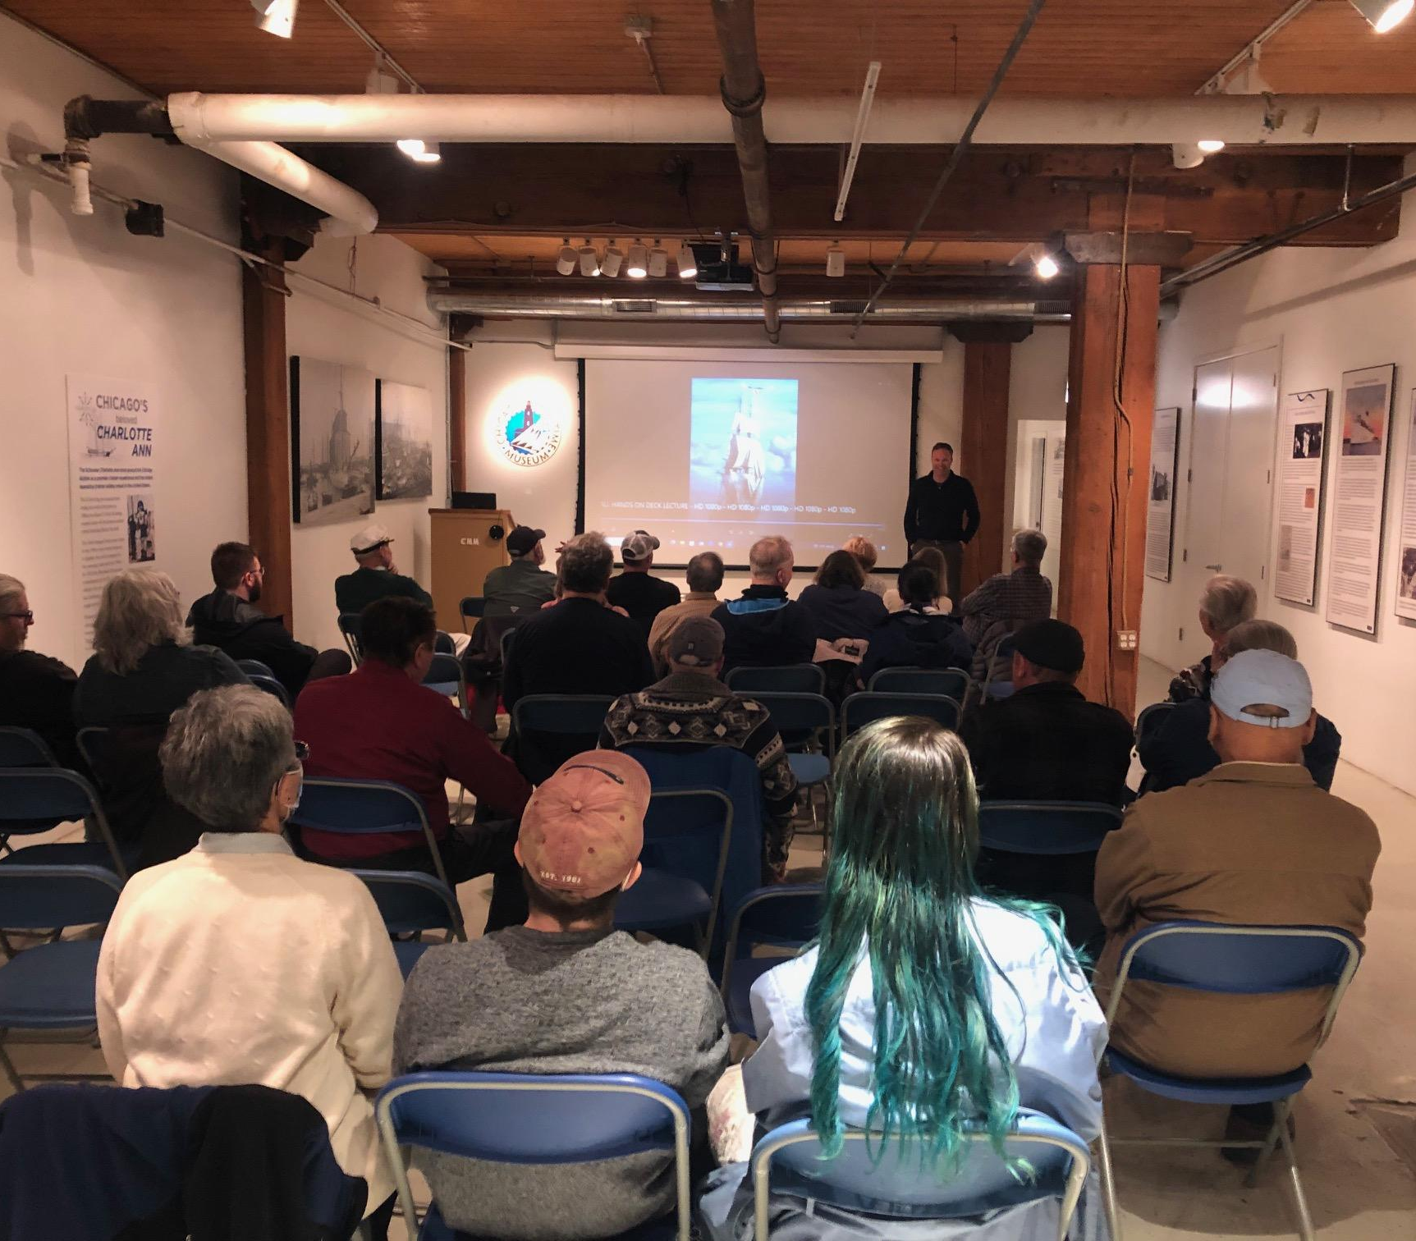
Long Range Committee Report
MEMBERSHIP
Young Members Meet up at Margaritaville Times Square Spring 2023
Encourage existing members to propose new members.
Work to attract more youth and female members.
Put a strong emphasis on a STC RailMeets feature of the website to connect owners and crew.
Create more social events for members.
Welcome Corinthian members with special skills to support STC regattas and activities.
Western Great Lakes Speaker Sessions

Slide 40
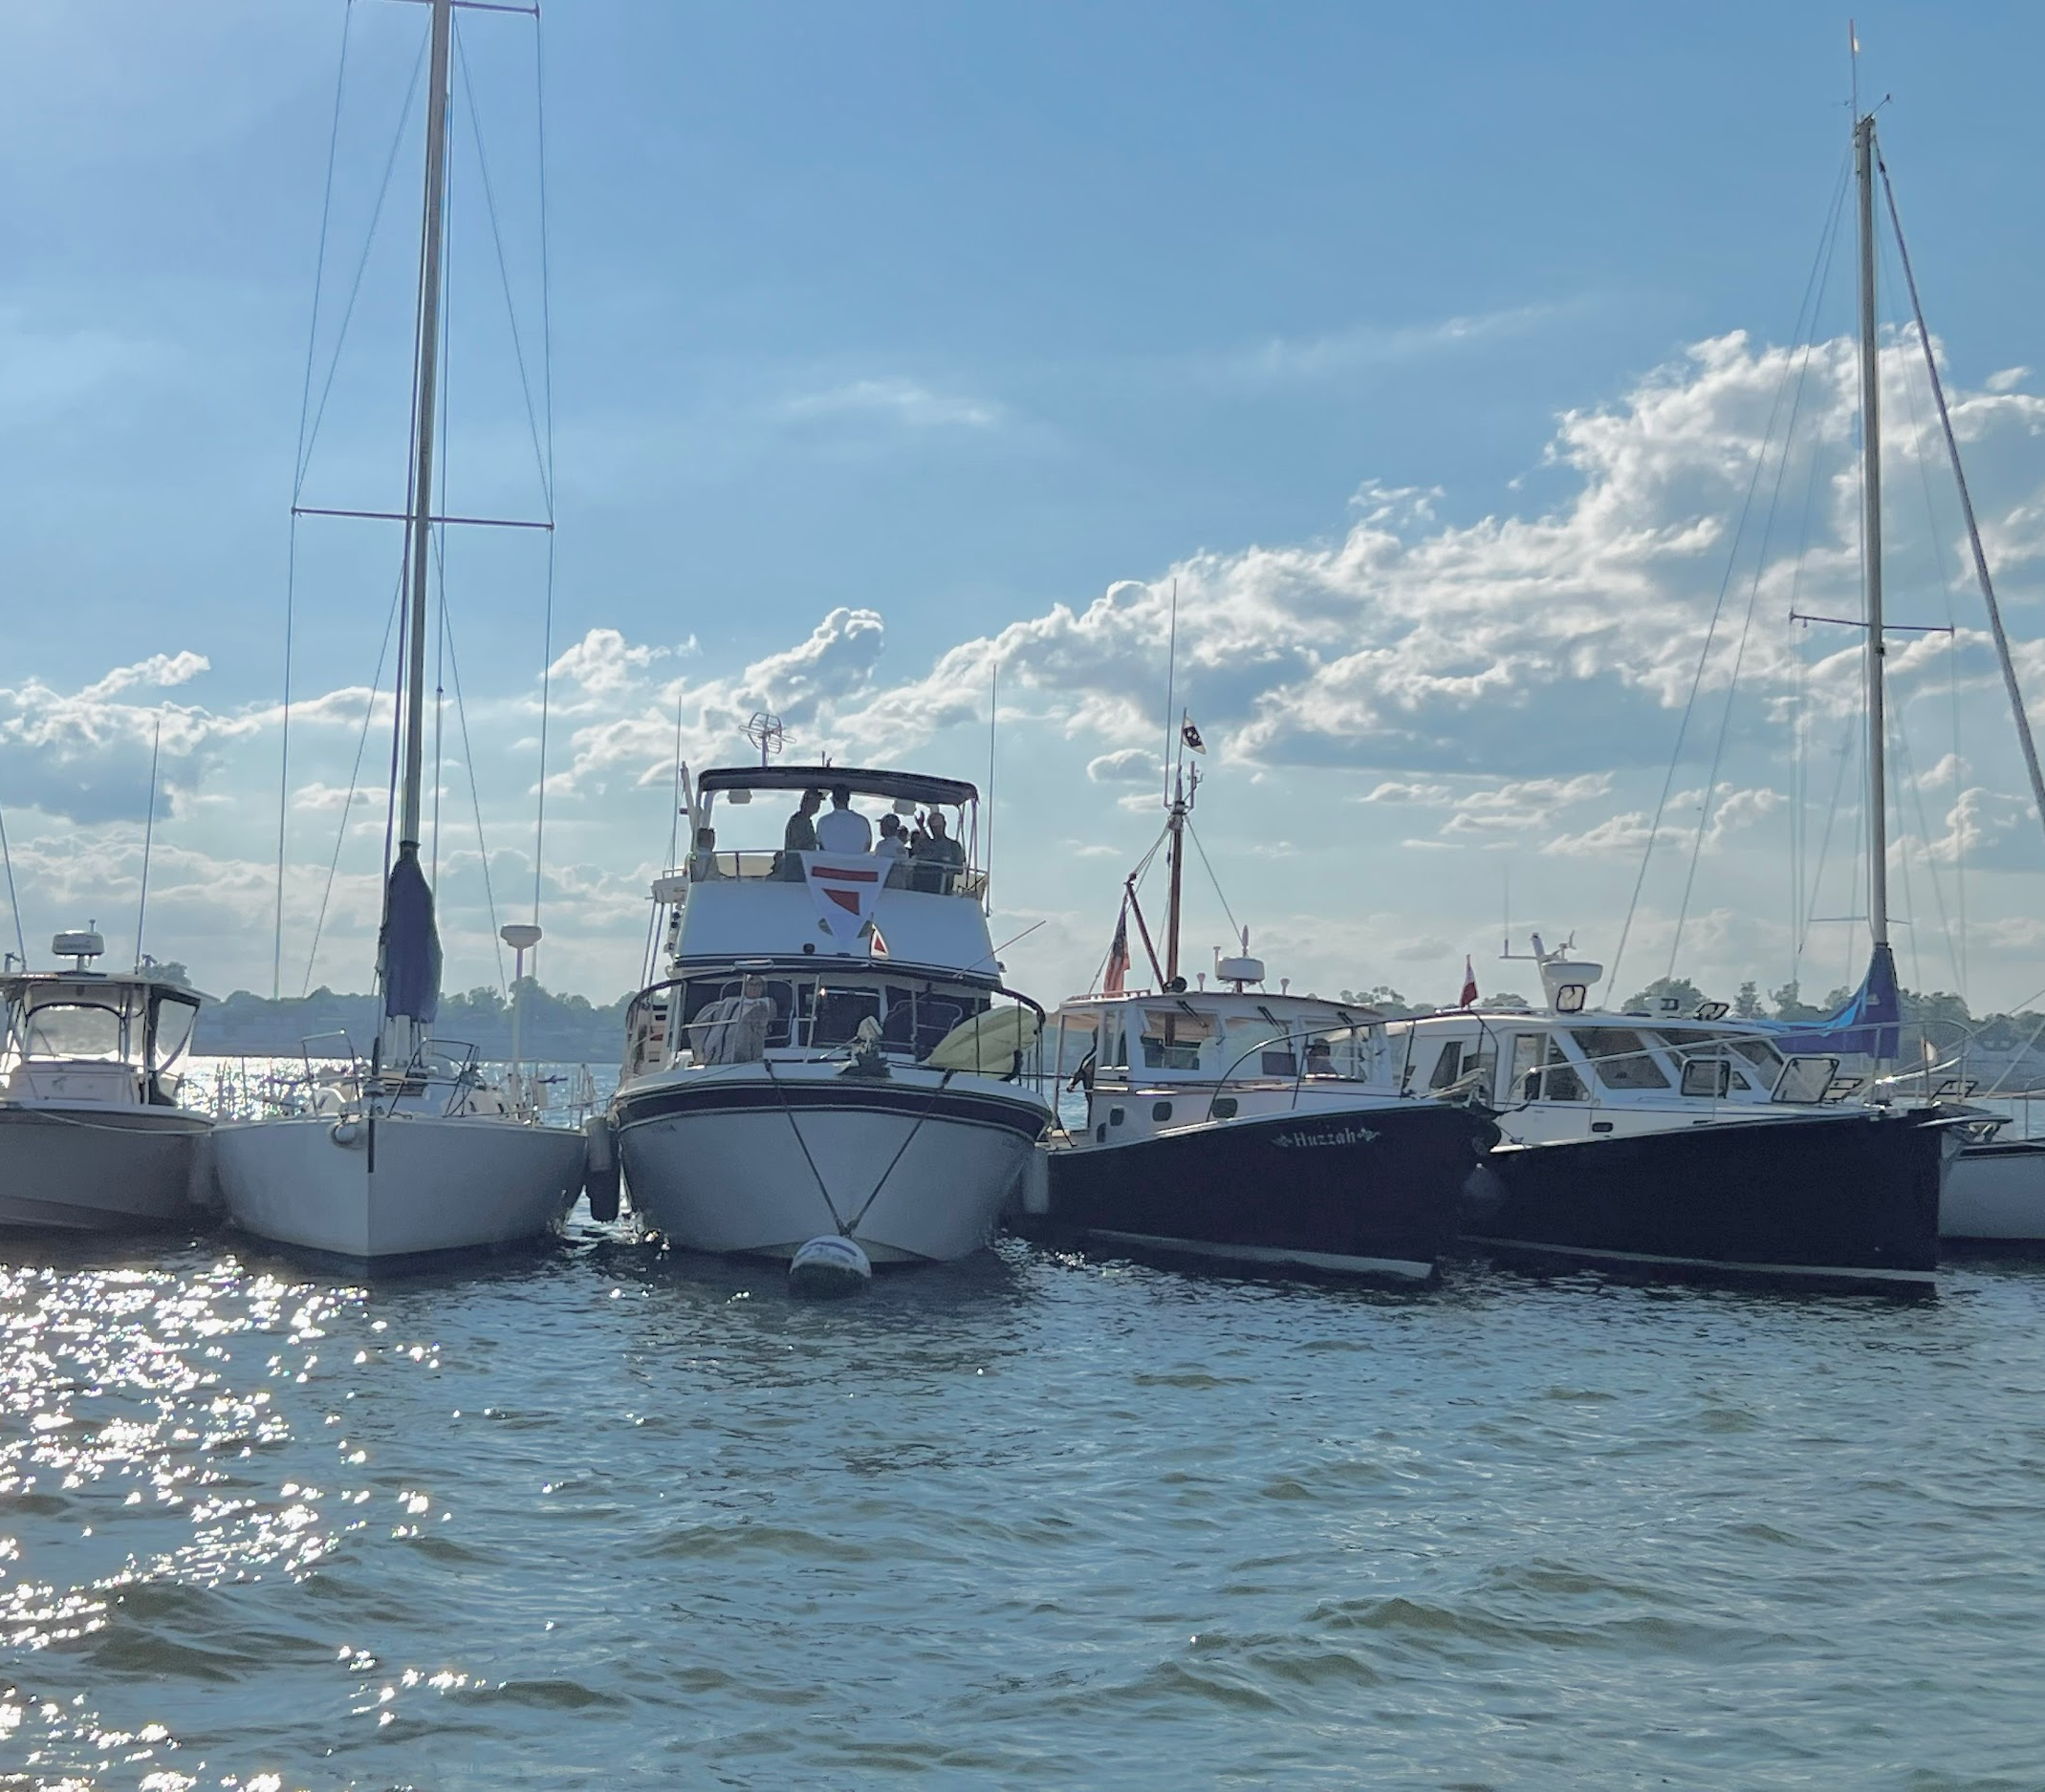
Long Range Committee Report
STATIONS
Create a handbook for stations.
Develop strong Station Captains
Develop a group of ambassadors to promote the Storm Trysail Club.
Long Island Sound Raft Up
Summer 2022

Slide 41
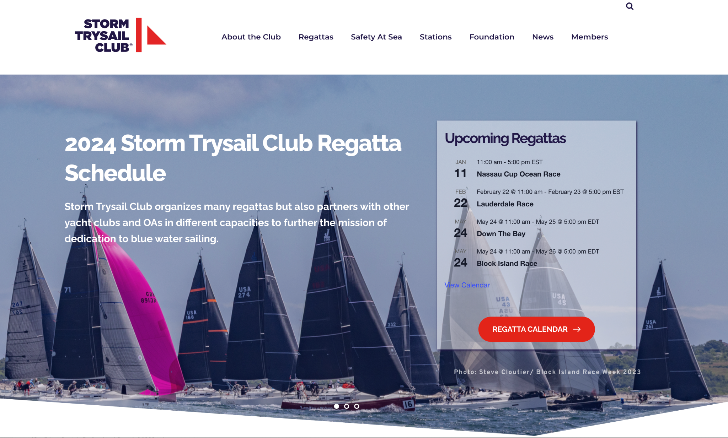
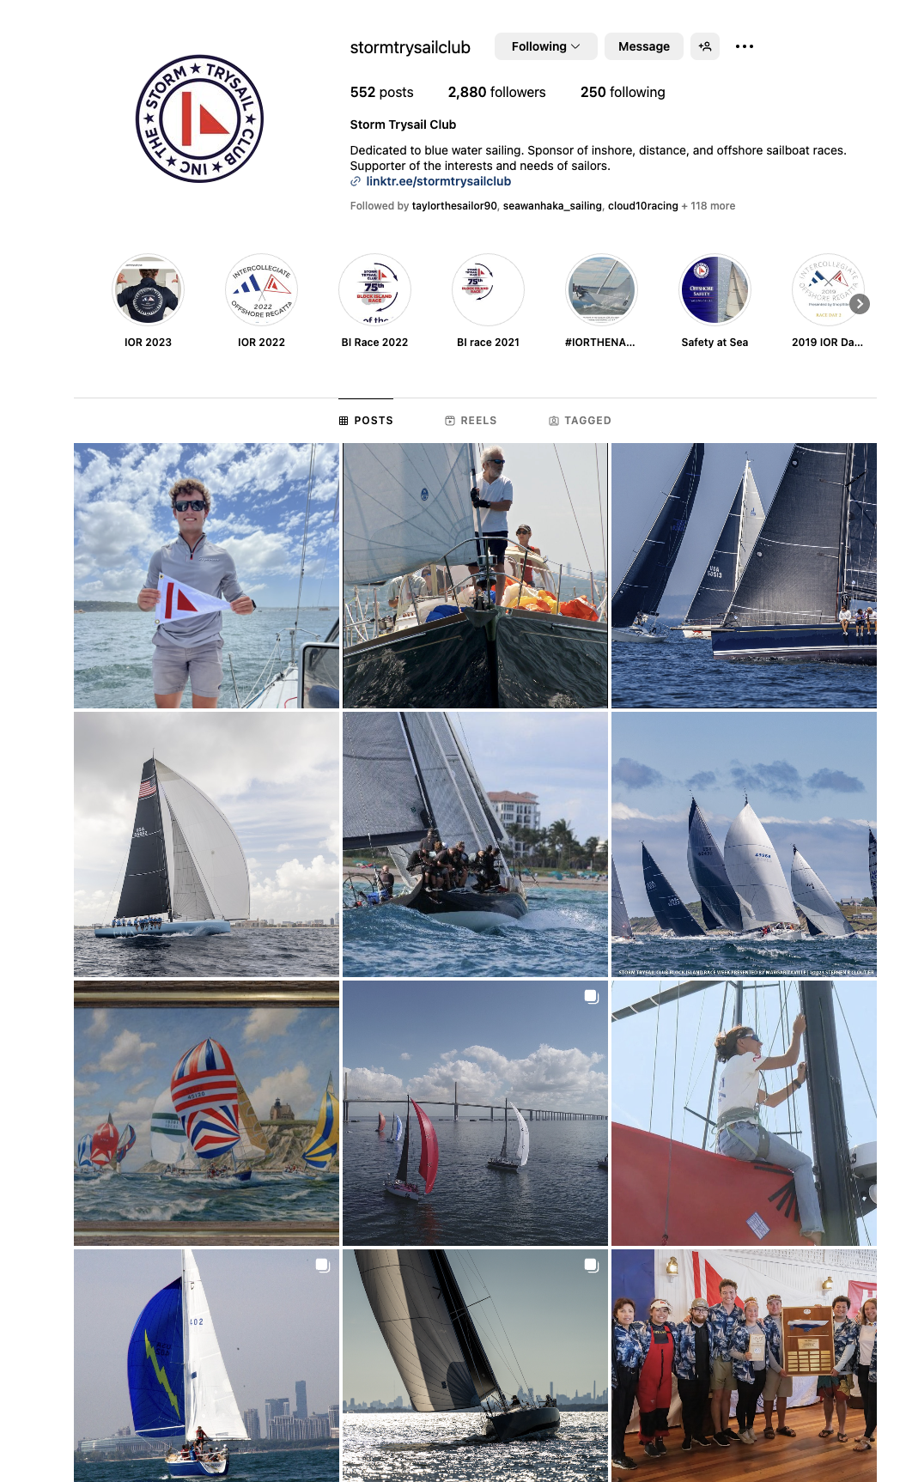
Long Range Committee Report
COMMUNICATIONS
The LRP Committee notes the improved communications over the past five years.

Slide 42
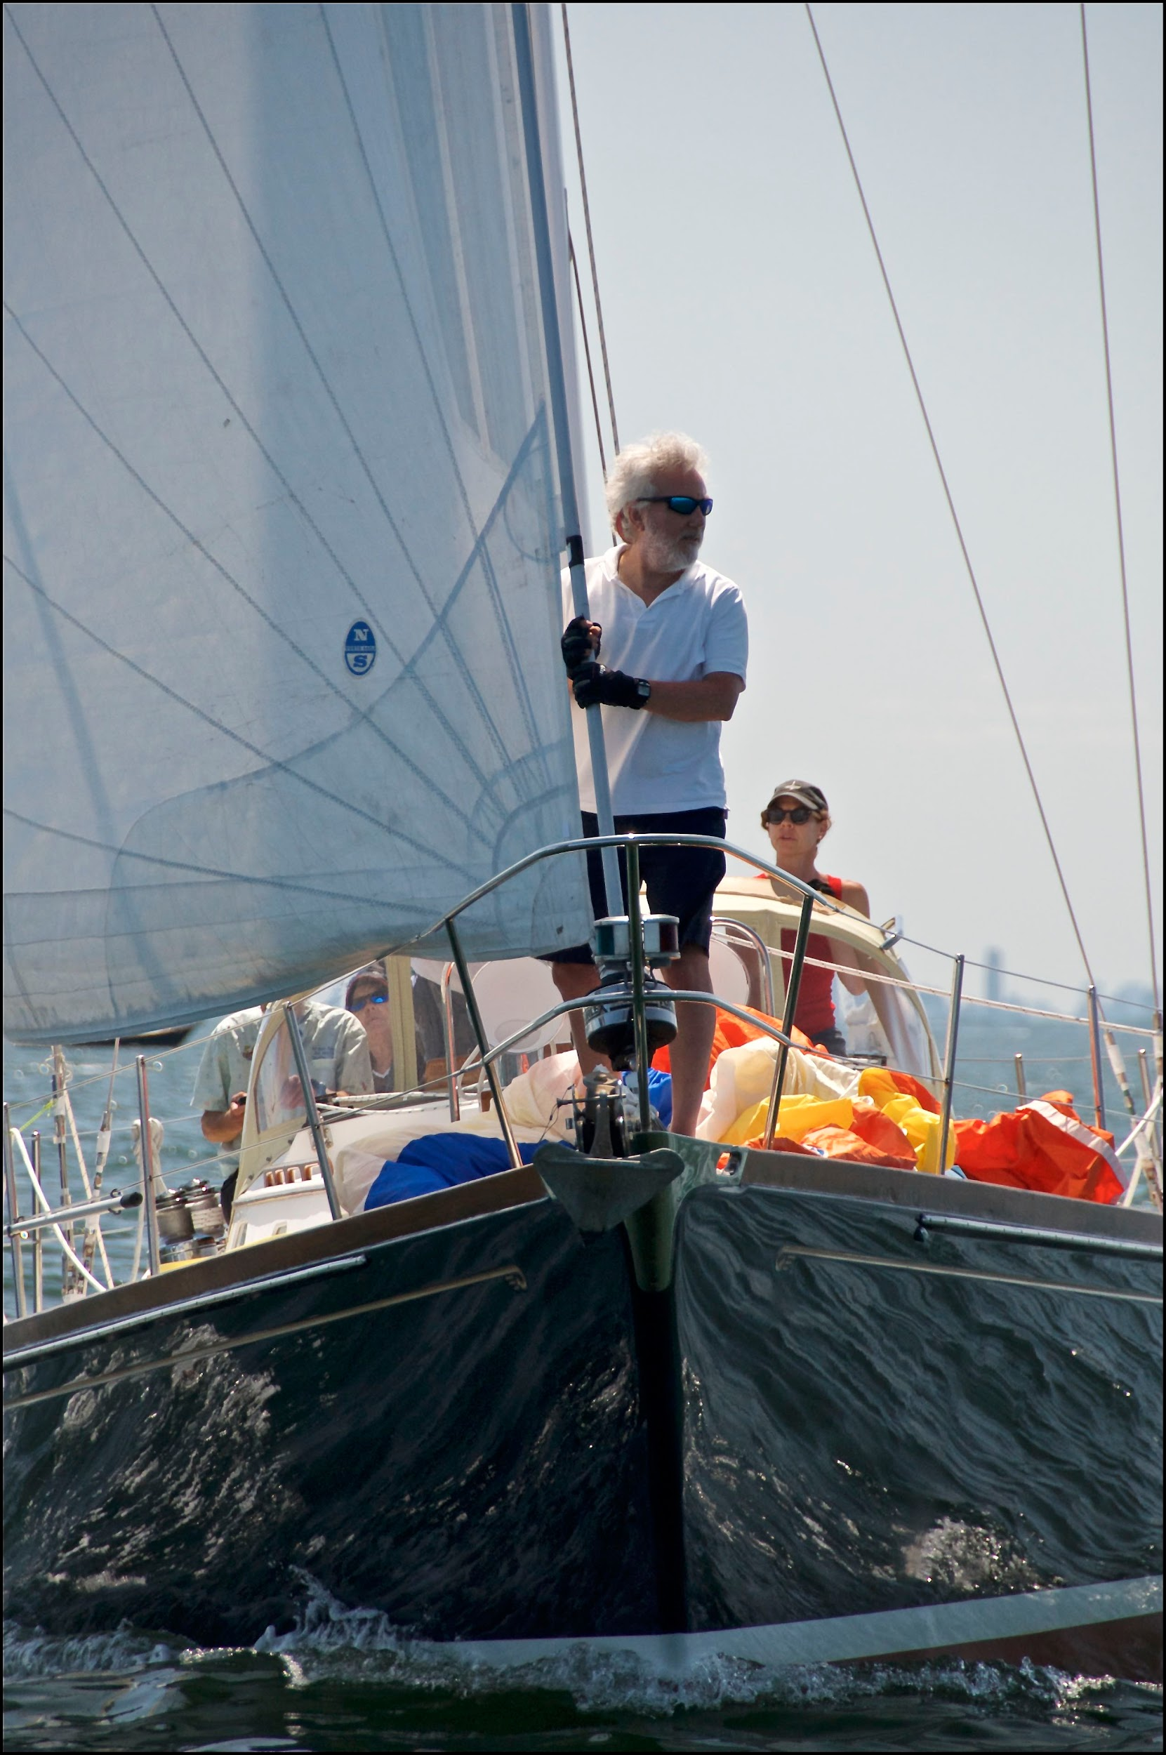
Long Range Committee Report
FINANCE
The STC has made great progress with financial operations.

Slide 43
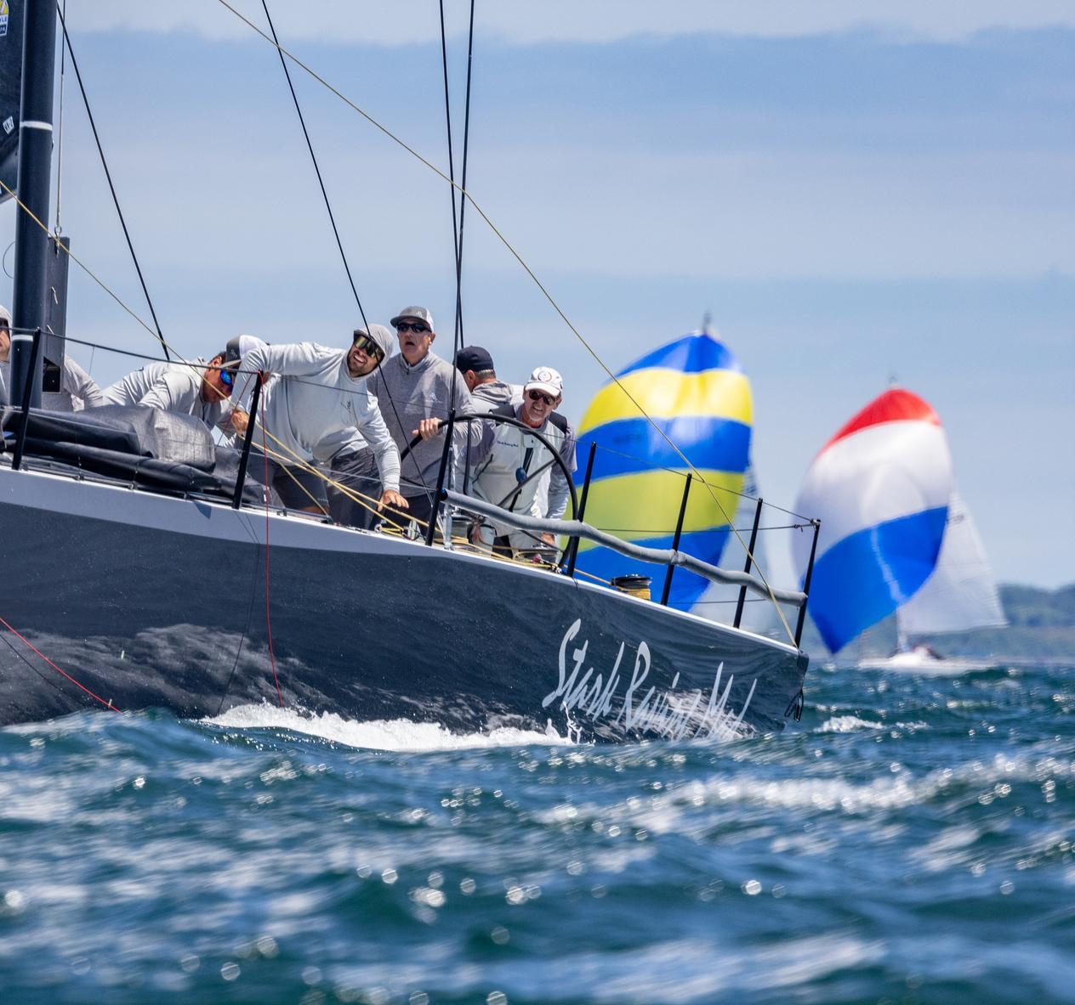
Long Range Committee Report
AMATEUR & PROFESSIONAL SAILING POLICY
The LRP Committee recommends that the Nomination Committee propose a professional sailor for the Board of Governors.

Slide 44
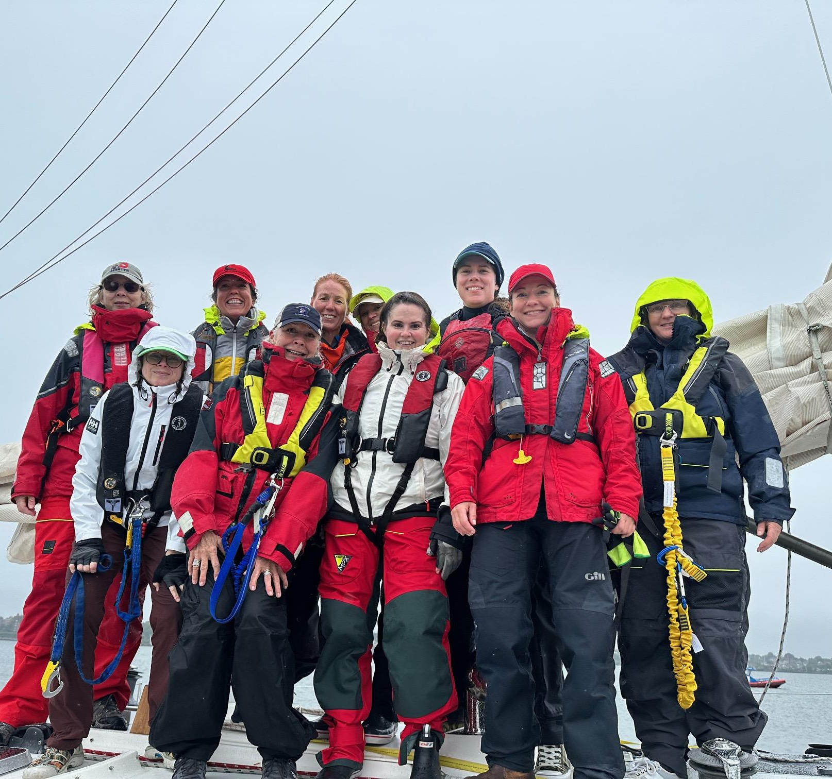
Long Range Committee Report
SAFETY-AT-SEA
Expand, enhance, and empower a revitalized Seamanship Committee.
Continue injecting Leadership into all seminars and forums.
Continue to offer on-the-water boat training and encourage sailors to practice on their own boats.

Slide 45
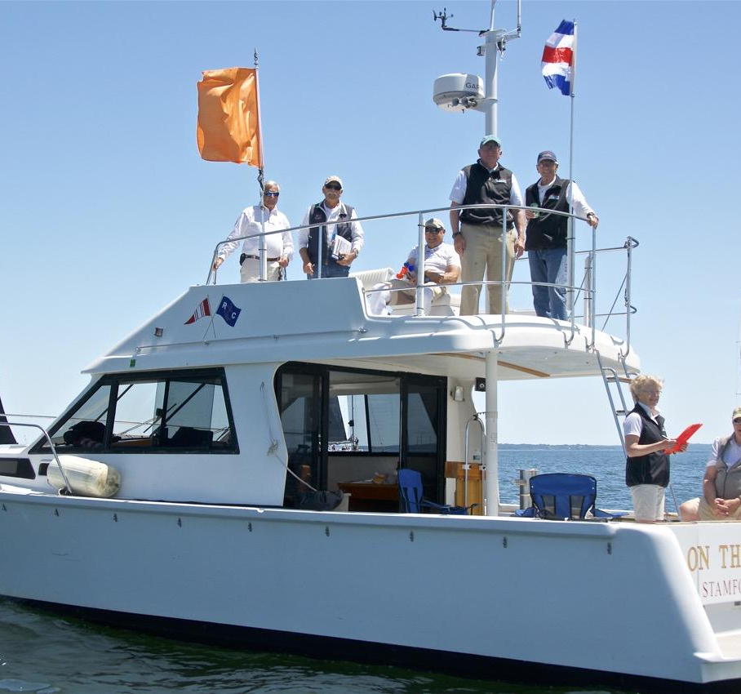
Long Range Committee Report
RACE MANAGEMENT
Encourage the use of a deputy race officer to build a bench for future race officers.
Encourage members to become certified race officials.

Slide 46
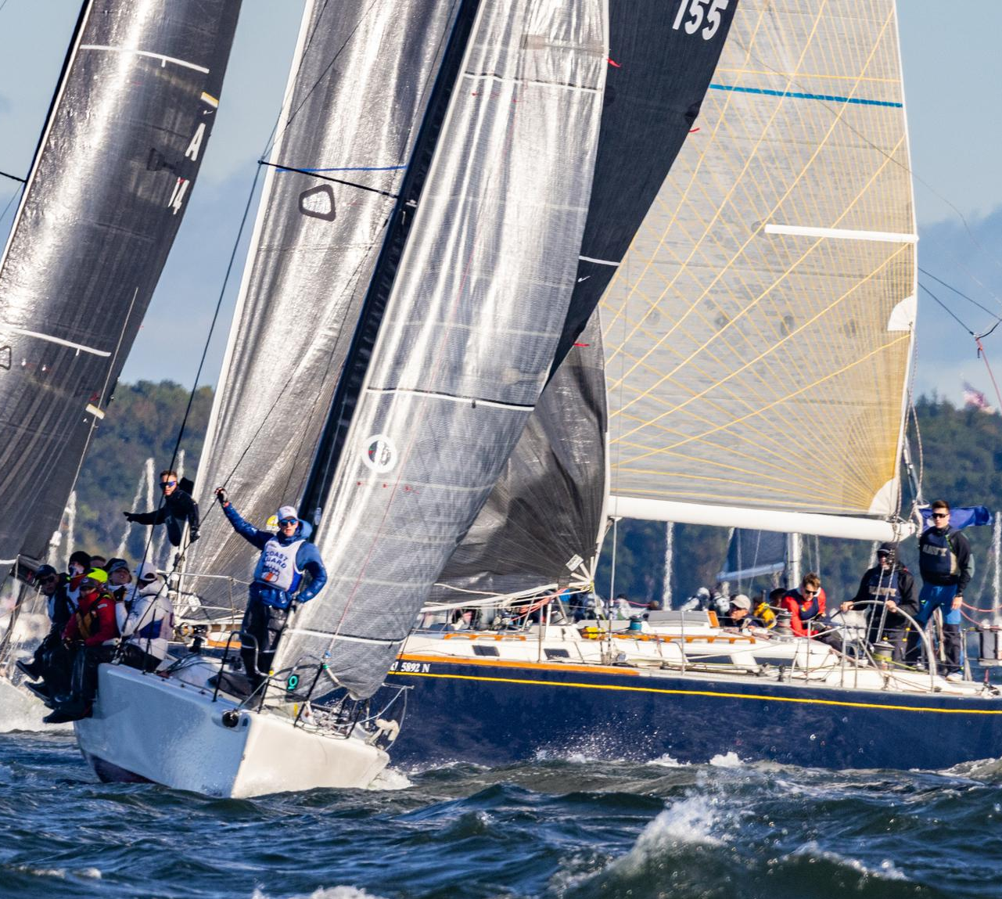
Long Range Committee Report
HANDICAP RATING RULES
Stay open-minded on the use of handicap rating rules.

Slide 47
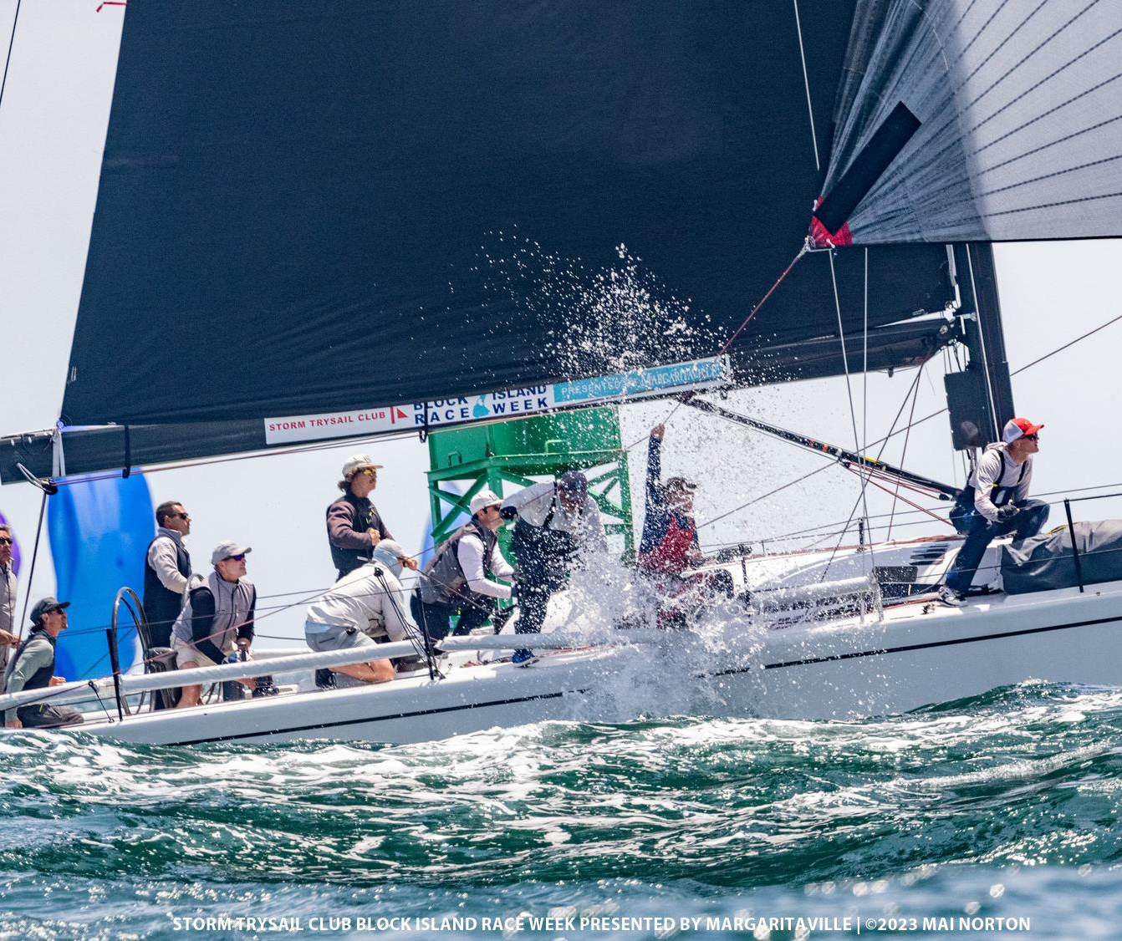
NOMINATING COMMITTEE’S REPORT
AJ Evans

Slide 48
Only Regular or Senior members should answer this question.
2024 ANNUAL MEETING BALLOT
2. Do you approve the motion for the Secretary/proxy to cast one ballot for the slate of Officers, Governors and Fleet Captain proposed by the Nominating Committee?
Officers 2024
Commodore, Ray Redniss
Vice Commodore, Andrew Weiss
Rear Commodore, Ty Anderson
Secretary, John D. Browning
Treasurer, Frederick Heerde
Governors 2024 Tom Bowler
John Edgecomb
Matt Gallagher
Christopher Lewis
Andree Isbrandtsen Pruett
Governors 2024-2025
Larry Fox
Sheila McCurdy
Ann Meyer
David Schaefer
Clarke Smith
Fleet Captain 2024
Rick Royce

Slide 49
CONGRATULATIONS
25-Year Pins
50-year Pins
Stephen Cook
Tom Closs, Jr.
Christopher Reyling
Matt Arnold
David Brennan
Jim Crane
Bradley Dellenbaugh
Erik Forsberg
Jeffrey Gibbons-Neff
Michael Hobson
Dirk Johnson
William Keyworth
Adam Loory
Donald Lovelace
Mark Myers
Mark Pellerin
Bert Sachse
Peter Sarelas
Jeffrey Siegal
Mike Toppa
George R. Walker

Slide 50
THANK YOU
Stuart Hebb
&
Andrew Berdon
Years of Service to the Board of Directors

Slide 51
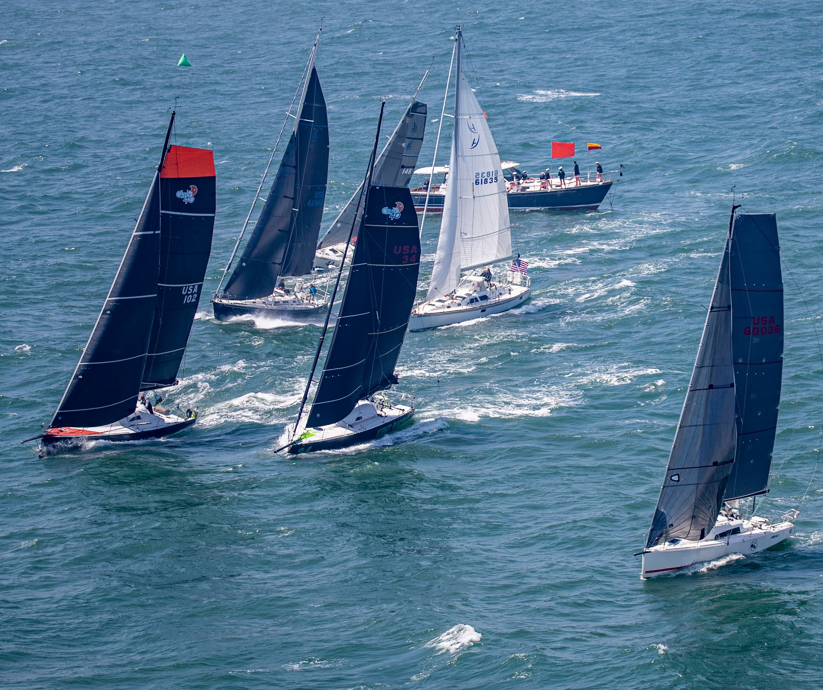
SEASON LONG EXCELLENCE TROPHIES
Nick Langone, Lee Reichart, and Dawn Riley

Slide 52
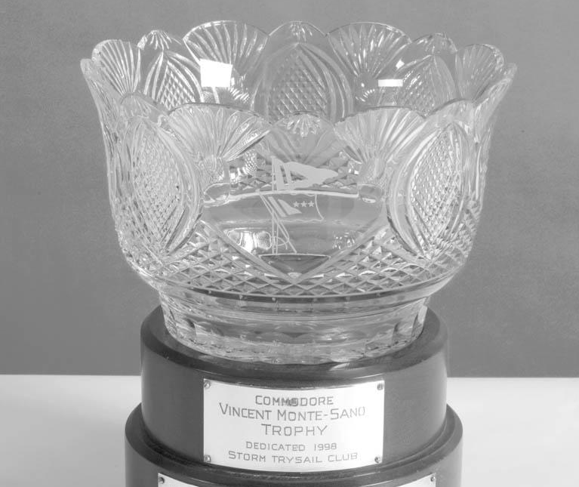
Monte-Sano Trophy for Racing Excellence
Awarded to the Storm Trysail Club member whose racing record is the most outstanding at the local, regional and national levels, bringing recognition and honor to the Club.

Slide 53
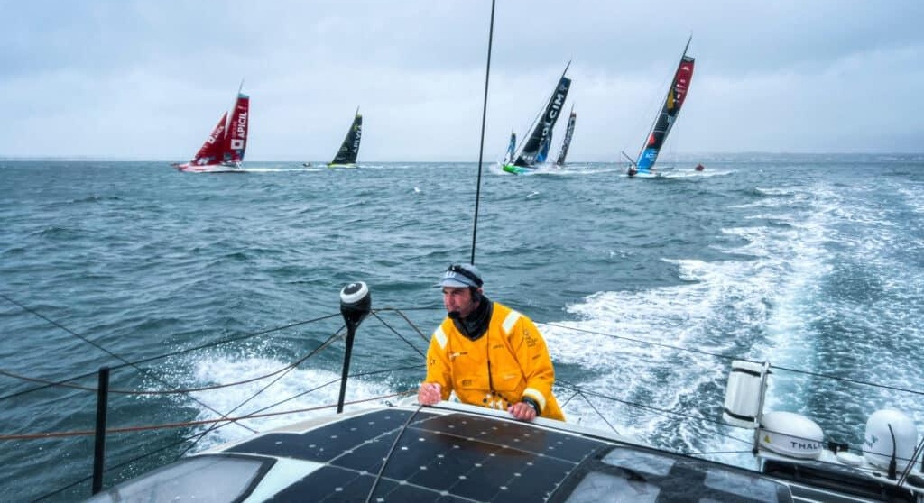
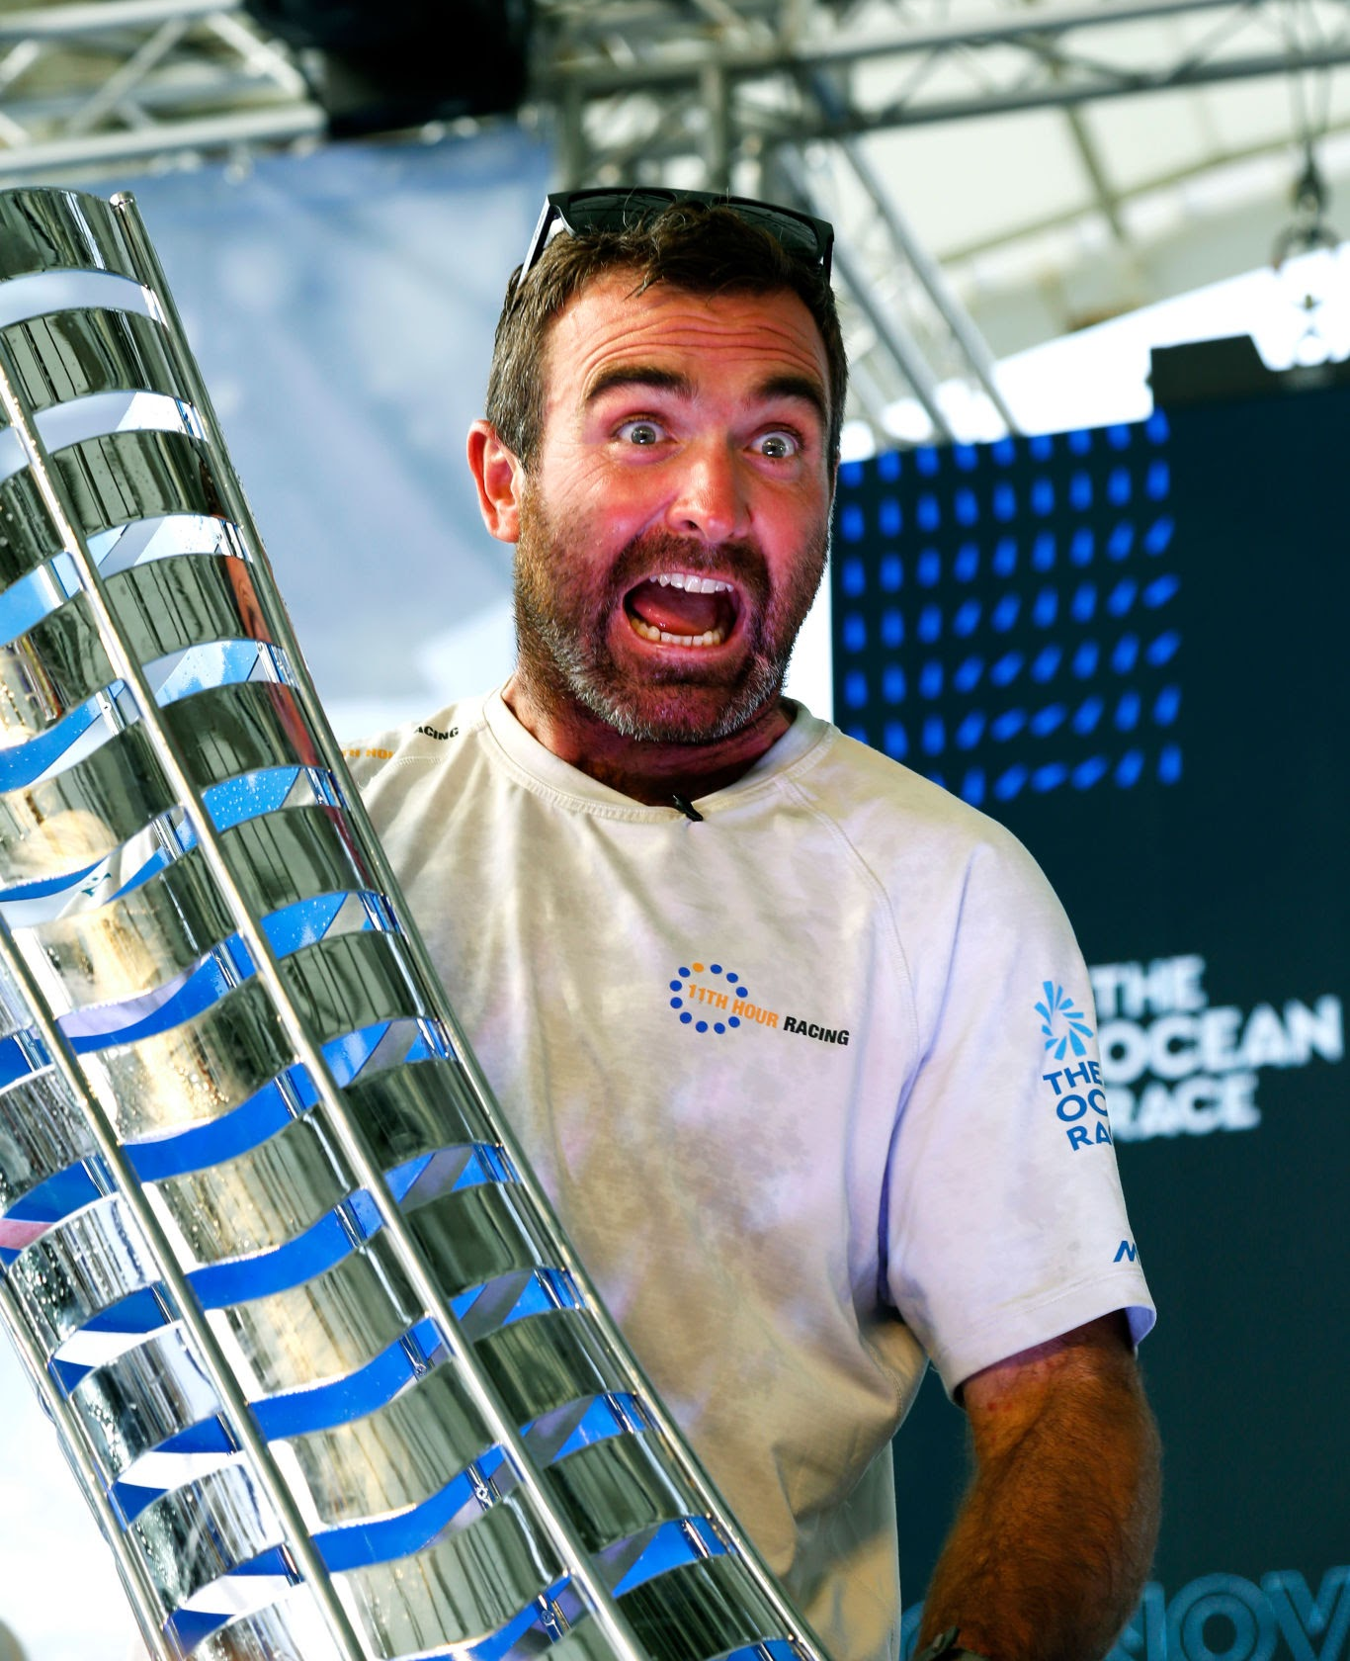
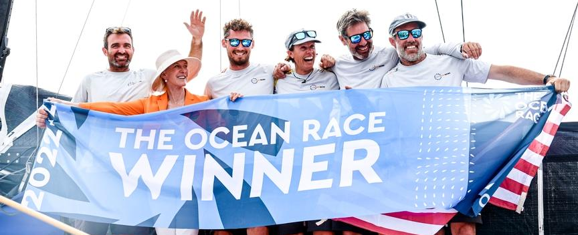
Monte-Sano Trophy for Racing Excellence
Awarded to the Storm Trysail Club member whose racing record is the most outstanding at the local, regional and national levels, bringing recognition and honor to the Club.
Charlie Enright

Slide 54
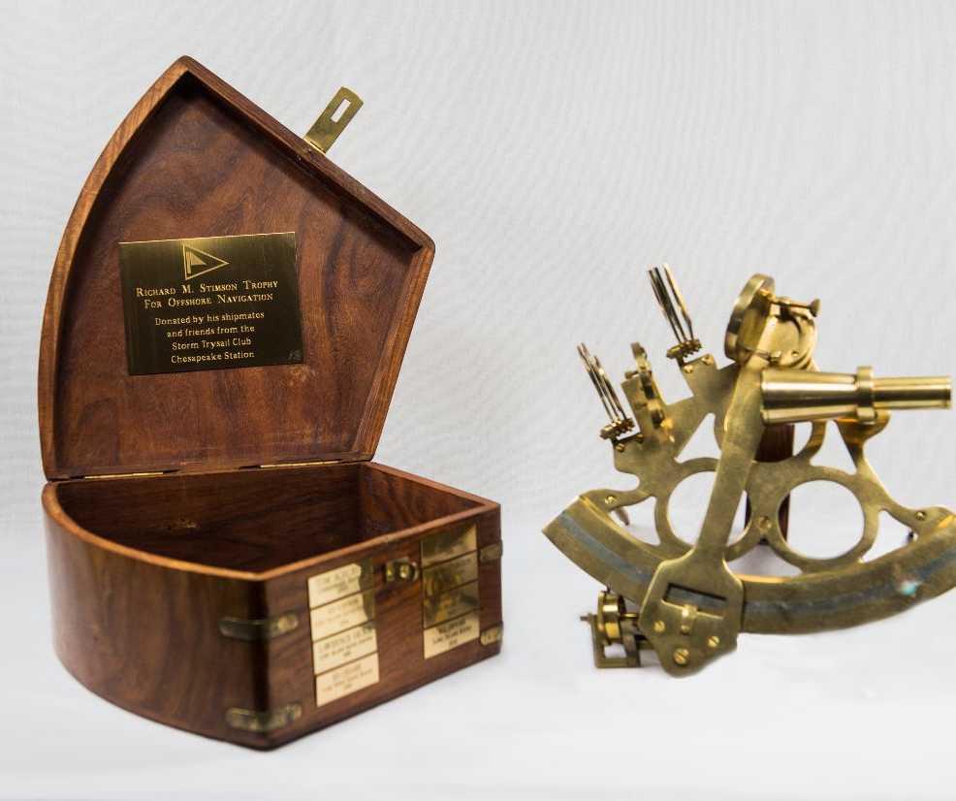
Richard M. Stimson Offshore Navigation Trophy
An award for the STC member who has navigated on a yacht (or yachts) with the best-combined fleet positions from among the races entered.

Slide 55
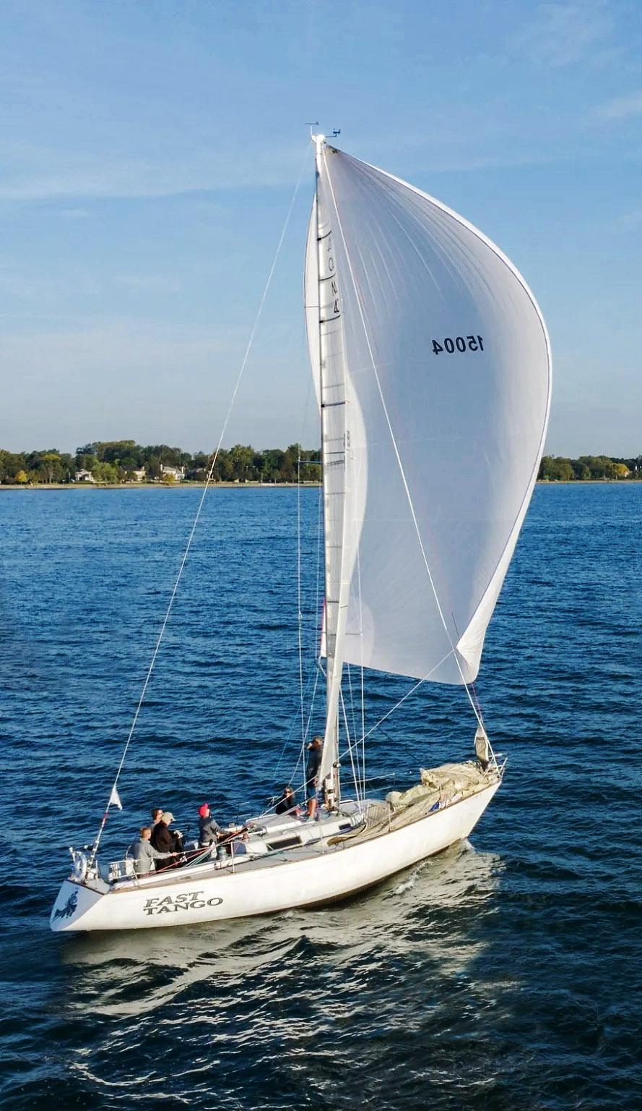
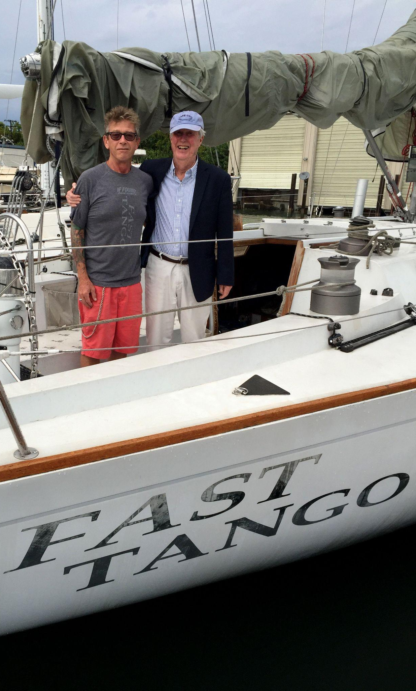
Richard M. Stimson Offshore Navigation Trophy
An award for the STC member who has navigated on a yacht (or yachts) with the best-combined fleet positions from among the races entered.
Tim Prophit

Slide 56
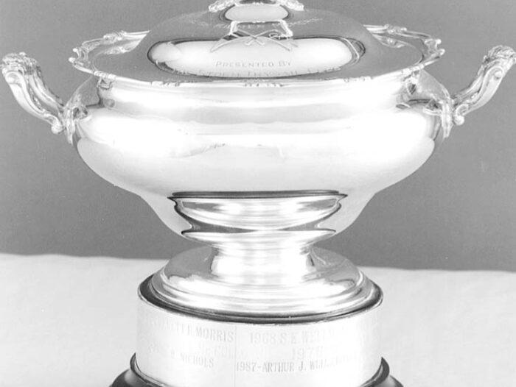
Hugh Killmer
The Trophy will be awarded at the sole discretion of the Flag Officers and Governors to a member who has, during the then current year, performed some noteworthy feat which has reflected honor upon the Club.

Slide 57
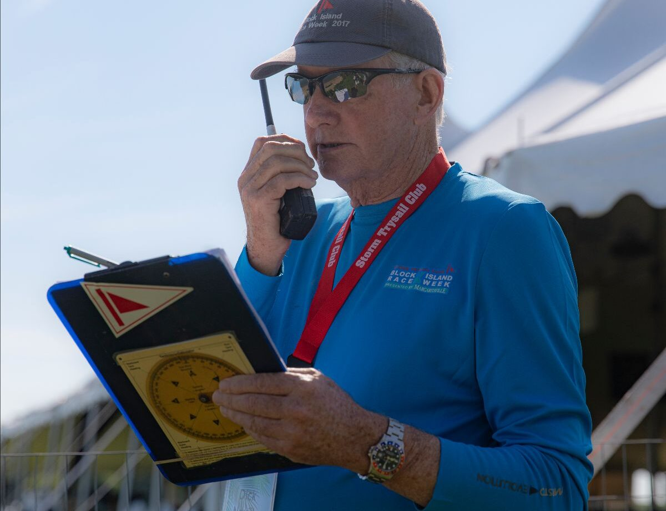
Hugh Killmer
The Trophy will be awarded at the sole discretion of the Flag Officers and Governors to a member who has, during the then current year, performed some noteworthy feat which has reflected honor upon the Club.
Dick Neville

Slide 58
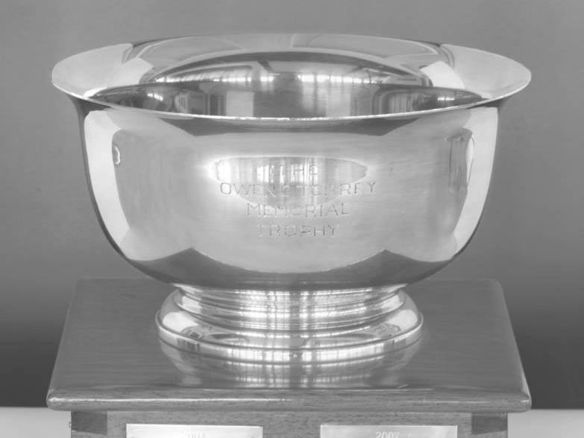
The Torrey Trophy
The Torrey is awarded annually to the person, who, in the opinion of the Governing Committee, has rendered “Outstanding Service: to the Storm Trysail Club.

Slide 59
The Torrey Trophy
The Torrey is awarded annually to the person, who, in the opinion of the Governing Committee, has rendered “Outstanding Service: to the Storm Trysail Club.
Bud Heerde

